Slide 1


eScholar Backdrop
Louisiana Secure ID
for End Users
version 2023
July/August 2023
Presenter:
Elaine Rulla
Notes:
Good afternoon. Welcome to the Louisiana Secure ID for End Users training. I am Elaine Rulla, and I will be your host for this presentation.
From LDOE, XXX and XXX are with us.
Our goal this afternoon is to introduce you to the Secure ID system. We will be recording today’s webinar in case others are interested in viewing this session.
I see we are about ready to get started. Just a few logistics before we begin: You are currently muted. If you wish to ask a question, please type it in the Q&A box. Take a moment and locate the Q&A box on your device. Since we have a large group attending today, we likely will answer most questions in a follow-up email post webinar.
After today’s webinar you will receive a copy of this slide deck as well as the Q&A document in a follow-up email.
Also, during the webinar, I will periodically ask you to respond to Poll questions. You will be able to answer the questions by clicking directly on your computer screen or your device.
Finally, we will be recording this webinar for your convenience.
Ok. Let’s get started. (To slide deck….)

Slide 2
SecureID Overview
ID Assignment Process
Near Match Resolution
Match Options and Search Options
Reports and Troubleshooting
Support and Wrap Up
Notes:
In today’s session we will cover, the Overview, ID Assignment Process, Near Match Resolution, Match Options and Search Options, Reports and Troubleshooting,
And Support and Wrap Up.

Slide 3
Participants will be able to:
Assign Student IDs in the SecureID system.
Locate a file of student records submitted to the SecureID System.
Use the SecureID application to resolve near matches.
Describe the criteria used by SecureID system in the matching process.
Notes:
At the conclusion of this session, participants will be able to:
Assign Student IDs in the SecureID system.
Locate a file of student records submitted to NYSSIS via AFP.
Use the SecureID application to resolve near matches.
Describe the criteria used by NYSSIS system in the matching process.

Slide 4
Notes:
The SecureID process is built on a new platform which encompasses new technology. The result is a more robust matching engine with more accurate matching and implementation flexibility. In addition, the end user will experience an improved, user-friendly interface.

Slide 5
Notes:
The File Format for SecureID is still file format 3.0. However, the specifications are now presented in a spreadsheet called Spec_Assign 3.0.

Slide 6
Notes:
The new and improved product provides a robust matching engine which produces reliable results. The interface is user-friendly and guides the user to make appropriate match decisions. The product is very flexible and is easy to configure.

Slide 7
SecureID Overview
ID Assignment Process
Near Match Resolution
Match Options and Search Options
Reports and Troubleshooting
Support and Wrap Up
Notes:
Lets’ start with the Overview.

Slide 8
#1
SecureID Overview
Notes:
SecureID Overview

Slide 9
SecureID Overview: Topics
Person Types
Person Type Codes
Key Terms
Overview of ID Assignment Process
Overview of Matching Process
Notes:
In this section, we will cover the concept of Person Types and Person Type Codes. Also, we will review a few key terms, the ID assignment process and the matching process.

Slide 10
Early Childhood
K12 Student
Staff
Workforce
Non-Public Student
Home-school
Louisiana Secure ID Person Types
Notes:
New for v 2023 is the concept of Person Types. The system now has the ability to separate data into different person types such as K12 Student or Staff. In Louisiana, the Person Types used are Early Childhood, K12 Student, Staff, Workforce, Non-Public Student and Homeschool.
Files which are loaded for K12 Students only search and retrieve K12 Student master records. The same is true for Staff records. They system only searches and retrieves master records and matching records within the Staff Person Type.
There is no cross over between the person type records.
In addition, users are authorized to view the appropriate Person Type data for their job responsibilities. If a user is only authorized to see K12 Student person type data, they will not be able to see any other type of person type data. In this case, the person type selections within the application will not be visible to the user. If the user is authorized to see both K12 Student and Staff person types, they will see both options in the Search Option and Match Option sections of the application. We will cover this more thoroughly later in the webinar.

Slide 11
Early Childhood
K12 Student
Staff
Workforce
Non-Public Student
Home-school
01
02
03
04
05
06
Person Type Codes
Notes:
Person Types are designated in the file upload with a person type code. The person type code is added to the file automatically by the student information system extract.
Click
Early Childhood is person type code 01
Click
K12 Student is person type code 02
Click
Staff is person type code 03
Click
Workforce is person type code 04
Click
Non-Public Student is person type code 05
Click
Homeschool is person type code 06
It is very important to know the Person Type you are responsible for as a user. If you only have one person type, your job is fairly simple. Write down the Person Type and the Person Type code you have access to.

Slide 12
Early Childhood
K12 Student
Staff
Workforce
Non-Public Student
Home-school
02
Louisiana Secure ID Person Types
Notes:
Users have designated person type access based on their role and where they work.
Click
For example, a public-school employee who only works with K12 students only has access to K12 Student records. The user will only see K12 Student Person Type data. There is no data change from previous versions for this type of users.

Slide 13
Early Childhood
K12 Student
Staff
Workforce
Non-Public Student
Home-school
02
03
Louisiana Secure ID Person Types
Notes:
However, a public K12 school employee who works with K12 students and Staff in the Louisiana Secure ID system will need access to both K12 Student and Staff Person Types.
Click
This type of employee will work with both K12 Student data and Staff data and must choose the correct person type for “Search Options and Match Options” within Louisiana Secure ID. This user will see both K12 Student Person Type data and Staff data. However, the system will not cross over from Student to Staff data or vice versa during the search or match process.
This type of user must be aware of the two data person types they are using: For example: Are they loading a file for 02 K12 Students or 03 Staff? It is a good idea to keep the person type code 02 or 03 in the file name so the user always knows what type of file they are working with.

Slide 14


K-12 Student
possible file name
Staff
possible file name
Option 1 With Person Type Code:
  02-06-01-2023.txt
Option 2 with Person Type Name:
  Student-06-01-2023.txt
Option 1 with Person Type Code:
  03-06-01-2023.txt
Option 2 with Person Type Name:
  Staff-06-01-2023.txt
File Naming Conventions for Person Types
Notes:
While there is no required file naming conventions for files loaded to Louisiana Secure ID, it is a good idea to keep the person type code or person type name in the file name. This way, the user will always know if the file they are loading is for K12 Students or Staff for example.
Click
For K-12 Students Option 1 uses the Person Type Code 02 in the file name. Option 2 uses the word Student in the file name.
Click
For Staff, Option 1 uses the Person Type Code 03 in the file name. Option 2 uses the word Staff in the file name.
More about this later.

Slide 15
Notes:
Key Terms:
Master Record-the current active record in the repository used for matching.
Submission Record-a record submitted to the system for matching. It is also called the input record.
SecureID-The State ID assigned by the Unique ID system.

Slide 16
Notes:
Click
Batch-A group of submission records submitted at the same time. They are stored as a unique entry and can be referred back to by batch number. A batch can consist of one or many submission records.
Click
Transaction-A transactions is a single submission record. The user can process a single transaction, for example, by working on a near match record in order to resolve the record and receive an ID, before an entire batch has finished processing. One or more transactions make up a batch.
Click
Match Threshold-Values are configured by the administrator which determine the Match, Near Match and No Match scores. The system uses these values to return matched records, near matches and no match records to the user.

Slide 17
Notes:
The SecureID system searches and finds existing IDs for students who already have one. It also creates IDs for student who do not match any records in the system. A near match student record is returned by the system so the end user can make an appropriate match decision. Finally, the system creates an output file, puts it in the appropriate folder for the end user to load to their source system.

Slide 18
Notes:
This is an overview of the ID assignment process.
Let’s go through each step in more detail.
Click
1. The first step in the process is to submit student records to SecureID in Assign 3.0 format.
All files submitted to Secure ID system will be placed in the Automatic File Processing folder and picked up automatically by the system. Note that it is still possible to upload a file manually, but it should not be necessary.
Click
2. After the file is submitted it automatically proceeds to the file or submission validation process.
This requires no human intervention as long as the file successfully passes validation.
During file validation, the system performs a review for issues with the batch file format and layout.
The format of the file is checked against the Spec_Assign 3.0 format to make sure that the correct number of fields exist in the file and that there is a header record and trailer record if these are required.
Results from the file validation process are File Upload Errors or File Upload No Errors.
If the file upload had errors, then the file is rejected by the system and needs to be fixed and resubmitted
Click
3. Files that are successfully validated are passed along for data validation.
During data validation the data is checked for items such as valid dates and codes.
Again, if the data in the file passes validation, then the file is passed along to the matching engine.
SecureID is configured to automatically validate data and this process will happen without user intervention.
Click
4. Files that successfully pass data validation begin the assign ID process.
This is the point at which the data is submitted to the matching engine.
At this stage, the submission records are compared with existing master records.
There are three possible outcomes from the matching engine:
there is no match for the record and a new ID will be assigned,
a match is found, and an existing ID will be assigned to the submission record,
or there are near matches identified and human intervention is required.
Click
5. If the matching engine finds near matches, then the user must resolve these near matches before the IDs can be assigned and downloaded. Records that need to be resolved manually remain in the Near Match stage until they have been resolved or cancelled.
Click
6. Transactions that have completed processing may be downloaded anytime. In a batch file, once the near matches are resolved or cancelled and every submission record has an ID assigned, the user may download the file containing the IDs.

Slide 19
Notes:
The Matching Process
Click
First, records are submitted to the system.
Click
The matching engine develops an index of potential matches to the submission record.
Click
The system compares the records and provides a match decision.

Slide 20
Notes:
In the ID assignment process, there are 3 possible outcomes as shown here:
Click
No Match,
Click
Match,
Click
and Near Match.
The most frequent result will be no match, followed by match.
Finally, a lower number of records will be returned as a near match.

Slide 21
Notes:
First, the record is input to the SecureID system.
click
If no match is found to any existing record, then the system will create a new ID.
click
2. If there is a match to an existing record then the existing ID is assigned, and the master record is updated.
click
3. If there is a near match then human intervention is required. Personnel have to visually compare the submission record to the master record. Individuals must resolve the near matches by deciding if these two records match or don’t match. The input record can also be canceled.

Slide 22
Notes:
Let’s look at an example of a record going through the matching process.
click
Student Jose R. Martinez is submitted to the system.
click
2. The matching engine develops a candidate record index containing all the records that the matching engine thinks might match the input record. The matching engine logic takes into account spelling errors, nicknames, etc.
click
3. Then the matching engine compares the input record, to each record in the system and assigns a match score for each comparison.
Here you can see the match score results when comparing the input record to the system.
The match score is used to determine whether or not input record is a match, a near match or no match to any of the master records. When making this decision the matching engine takes into account the thresholds that have been configured.
In this example, we can see that Jose R. Martinez and Joseph Martinez share a partial match on the first name, matching last name, and matching gender and birthdate. He therefore received the matching score of 94. This record is considered a match.

Slide 23
SecureID Overview
ID Assignment Process
Near Match Resolution
Match Options and Search Options
Reports and Troubleshooting
Support and Wrap Up
Notes:
The ID Assignment Process

Slide 24
#2
ID Assignment Process
Notes:
The ID Assignment Process

Slide 25
ID Assignment Process Topics
File Format Specifications
The ID Assignment Process
File and Batch Validations
Batches
Transactions
Notes:
ID Assignment Process Topics:
File Format Specifications
The ID Assignment Process
File and Batch Validations
Batches
Transactions

Slide 26
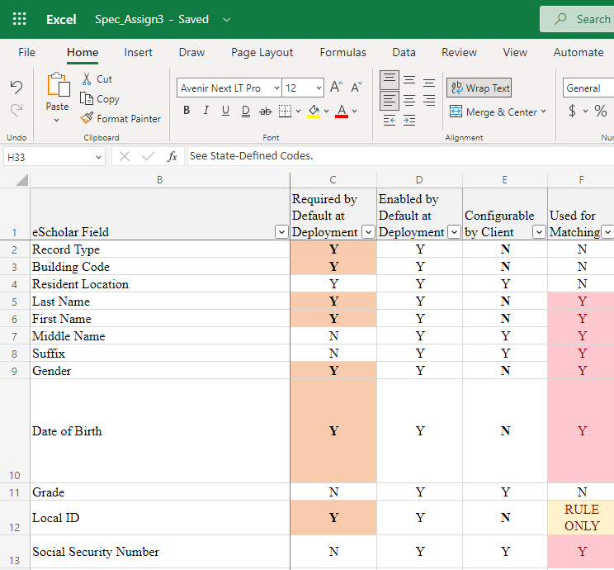
Spec_Assign 3.0
The detailed file format information is now available in the Spec_Assign 3.0 Format Guide.
Spec_Assign 3.0 replaces the former UID_Batch_File_Format v3.01
The file format has NOT changed from File Format 3.0
The format guide is now available in spreadsheet format to allow the user to easily search and locate the desired information
Notes:
The Spec_Assign 3.0 Spreadsheet contains the specifications
which were formerly called File Format 3.0.

Slide 27
Notes:
Let’s look at the File Validation process.
The file structure should be created by your source system extract.
However, it is possible to edit a file and accidently change the structure of the file.
In this case, the file must be set back to Spec_Assign 3.0 specifications in order to load.

Slide 28
File Validation
System performs a review of the format and layout for the submitted file.
The submitted file is compared to the Spec_Assign 3.0 required format.
Files that fail file validation need to be corrected and then re-uploaded for processing by the system.
Notes:
System performs a review of the format and layout for the submitted file.
The submitted file is compared to the Spec_Assign 3.0 required format.
Files that fail file validation need to be corrected and then re-uploaded for processing by the system.

Slide 29
File Validation
Filenames can contain upper/lower case alphanumeric characters, periods, underscores or hyphens.
No spaces or special characters.
File names do not have to be unique.
Notes:
Filenames can contain upper/lower case alphanumeric characters, periods, underscores or hyphens.
No spaces or special characters.
File names do not have to be unique.

Slide 30
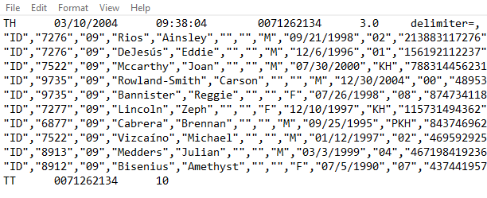
Spec_Assign 3.0 Format
Header Record: TH
Detail Record: ID
Trailer Record: TT
**no empty spaces or data after last trailer column**
Notes:
A header record and trailer record are required.
The header record is the first line of data in the file and the trailer record is the last.
In addition, the header record is identified with a TH and the Trailer Record starts with TT.
Next, let’s look at the information that can be each type of record.

Slide 31
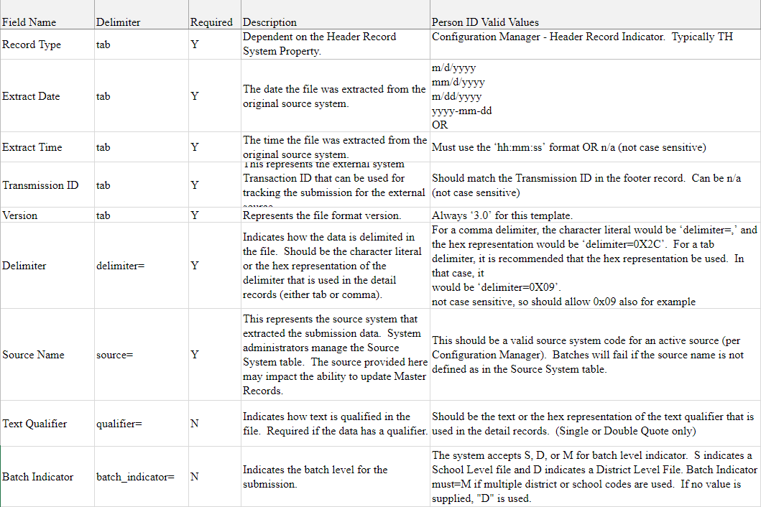
Header Layout
The Spec_Assign 3.0 header record layout
Notes:
This slide shows the Spec_Assign 3.0 header record layout.
The Header Record layout includes the field name, delimiter, required indicator and comments.

Slide 32
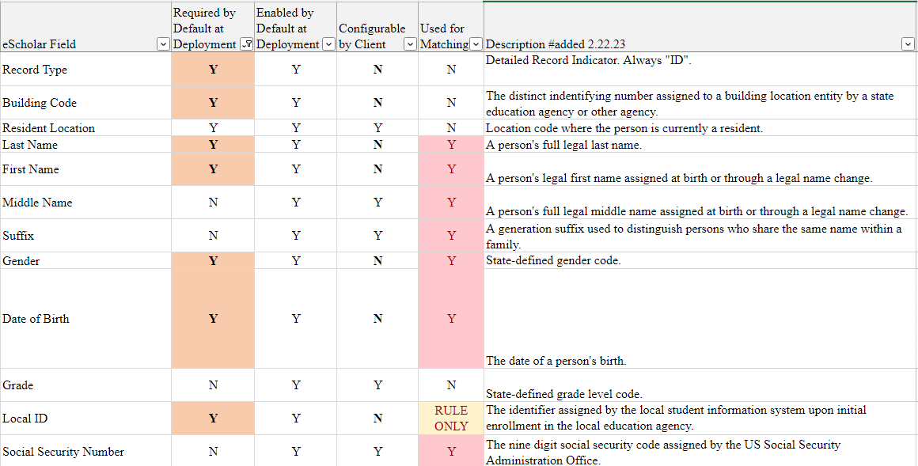
Detail Layout
The Detail Record Layout contains the required by default, enabled by default, configurable and used for matching columns.
Notes:
The Detail Record Layout contains the required by default, enabled by default, configurable and used for matching columns.
Additional fields may be viewed in the Spec_Assign 3.0 spreadsheet.

Slide 33
Detail Layout
The Spec_Assign 3.0 record layout is described in detail in the format document.
The layout descriptions include the field name, required, system data type, used for matching indicator and detailed comments about each field.
Vendors use the Spec_Assign 3.0 record layout details to develop the record format for loading data.
The image shows only a short view of the Detail Layout. View the Spec_Assign 3.0 spreadsheet for the remaining fields.
Notes:
The Assign 3.0 record layout is described in detail in the format document.
The layout descriptions include the field name, required, system data type, used for matching indicator and detailed comments about each field.
Vendors use the Spec_Assign 3.0 record layout details to develop the record format for loading data.

Slide 34
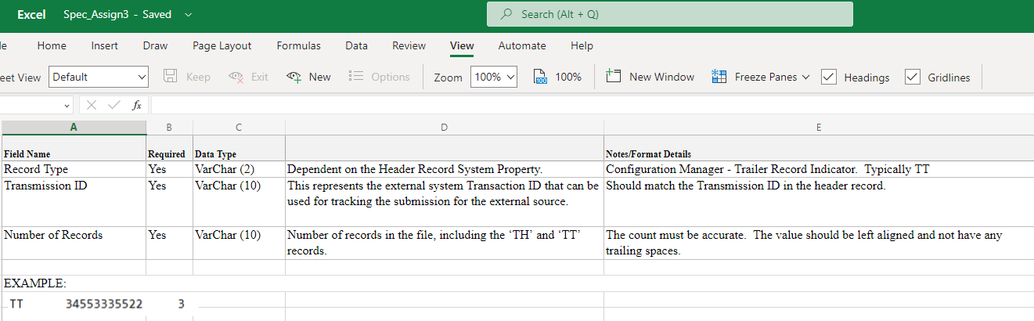
Trailer Layout
The Spec_Assign 3.0 trailer record layout includes the record type, transmission ID, and number of records.
Note, the number of records includes the TH and TT records plus the number of detail records.
Notes:
The Spec_Assign 3.0 trailer record layout includes the record type, transmission ID, and number of records.
Note, the number of records includes the TH and TT records plus the number of detail records.

Slide 35
Data Validation
The Spec_Assign 3.0 detail data layout contains specific requirements for each field name including whether the field is required, data type and length, and whether the field is used in the matching process.
These specifications are used in the data validation process.
Notes:
The Spec_Assign 3.0 detail data layout contains specific requirements for each field name including whether the field is required, data type and length, and whether the field is used in the matching process.
These specifications are used in the data validation process.

Slide 36
Notes:
All the data you will see in this session is fake data and does not represent any real person.

Slide 37
Batches
Notes:
A Batch consists of one or more submission records input at the same time.

Slide 38
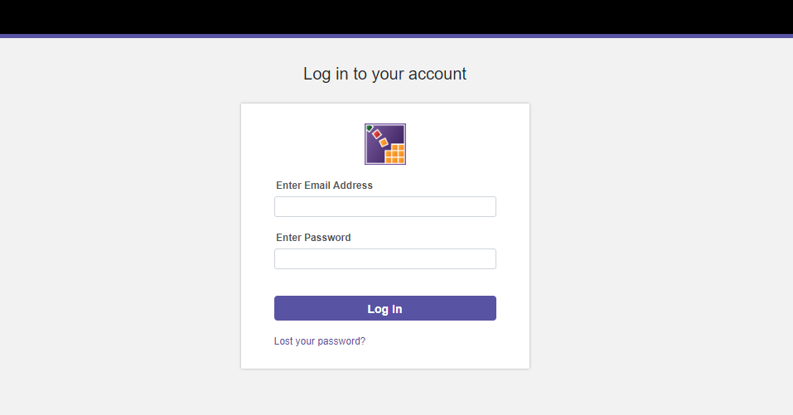
The user will log into their account.
Notes:
The user will log into their account.

Slide 39
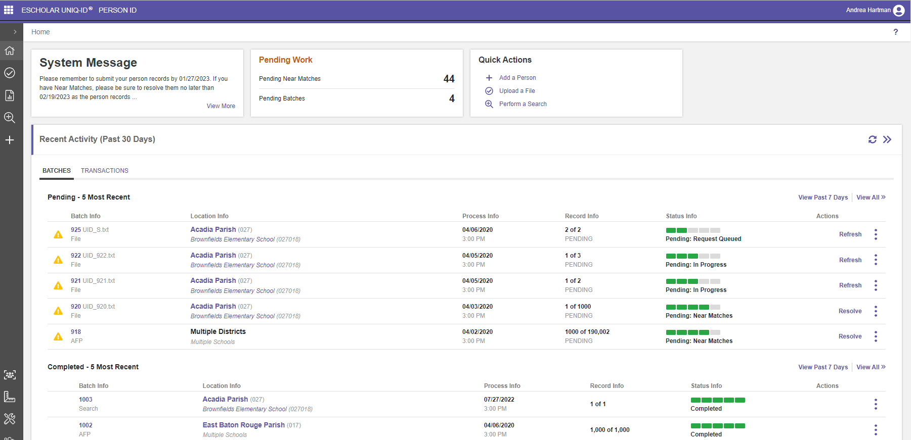

Batches and The ID Assignment Process
Notes:
Click
The user will land on the Home page for Person ID. On the left side of the screen is a gray collapsible menu. The menu consists of Home, Match Options, Reports, Search and Add a Person.
Click
2. The body of the page contains two tabs: one for Batches and one for individual Transactions.
Click
3. The body also contains a list of the five most recent pending batches (or transactions) and the 5 most recently completed batches (or transactions)

Slide 40
Let’s examine the information available on the batch tab. Click the batch number to see the batch profile information.
Notes:
Let’s examine the information available on the batch tab. Click the batch number to see the batch profile information.

Slide 41
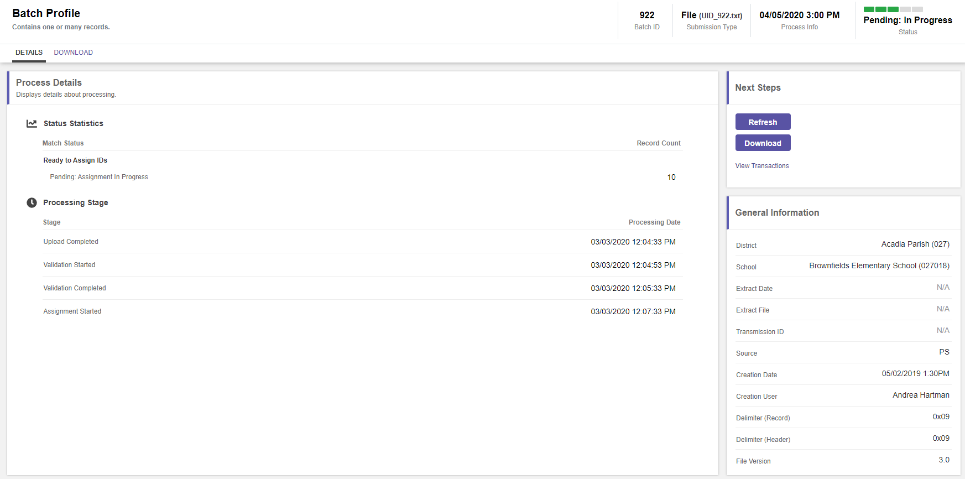
The batch profile page indicates that the batch is pending ID assignment, provides the processing stage details, the batch general information and the next action steps in the process.
Notes:
The batch profile page indicates that the batch is
Click
pending ID assignment,
Click
provides the processing stage details,
Click
the batch general information and
Click
the next action steps in the process.

Slide 42
Next, click the location to see the location profile page.
The location info will contain the name and code of the Parish.
Notes:
Next, click the location to see the location profile page. The location info will contain the name and code of the Parish.

Slide 43
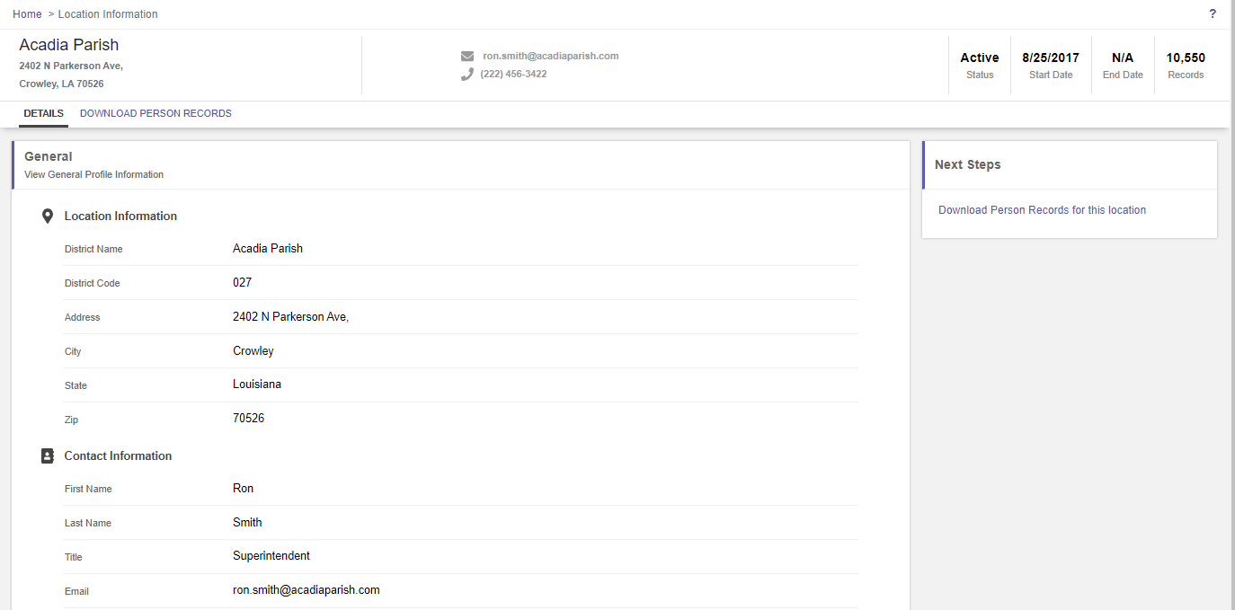
The location information page provides information about the location and the contact.
Notes:
The location information page provides information about the location and the contact.

Slide 44
The process information tells us the batch submission date and time, the number of records and the current batch status.
Notes:
The process information tells us the batch submission date and time, the number of records and the current batch status.

Slide 45
The action button, in this case, refresh, allows the user to initiate the next available action.
Notes:
The action button, in this case, refresh, allows the user to initiate the next available action.

Slide 46
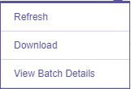
The action icon (also called an ellipse), allows the user to view other options such as refresh, download or view batch details.
Notes:
The action icon (also called an ellipse), allows the user to view other options such as refresh, download or view batch details.

Slide 47
When the batch has finished processing, it will appear under the five most recently completed and the user can download the assigned IDs.
Notes:
When the batch has finished processing, it will appear under the five most recently completed and the user can download the assigned IDs.

Slide 48
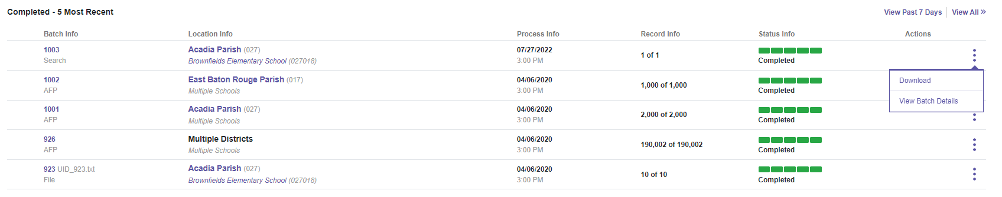
Batch 1003 has completed processing and we can download the IDs by clicking the download button on the action tab.
Notes:
Batch 1003 has completed processing and we can download the IDs by clicking the download button on the action tab.

Slide 49
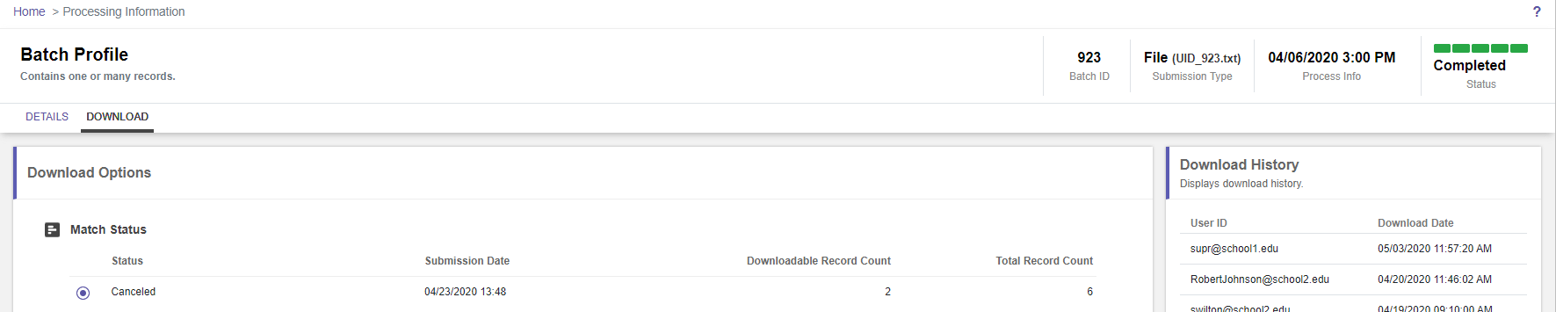
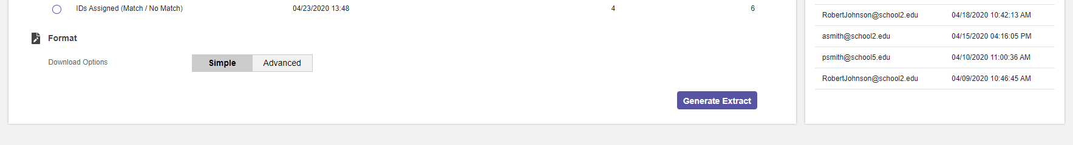
After clicking the download button, the user lands on the Batch Profile download tab which provides the download options. The batch contains 6 total records consisting of 2 cancelled records and 4 IDs matched. The user will now click generate extract.
Notes:
After clicking the download button, the user lands on the Batch Profile download tab which provides the download options. Batch 1003 contains 6 total records consisting of 2 cancelled records and 4 IDs matched. The user will now click generate extract.

Slide 50
Transactions
Notes:
A transaction is one individual submission record.

Slide 51
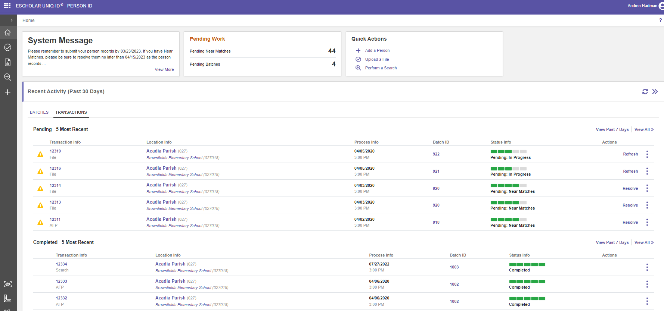
Transactions
Notes:
New for version 2023 is the concept of working with individual transactions.
The user can select the transaction tab and see a list of the 5 most recent pending and 5 most recently completed transactions.
The user can resolve and download an individual transaction before the entire batch has finished processing.

Slide 52

Click the action icon or ellipse to see the actions.
Notes:
Click the action icon or ellipse to see the actions.

Slide 53
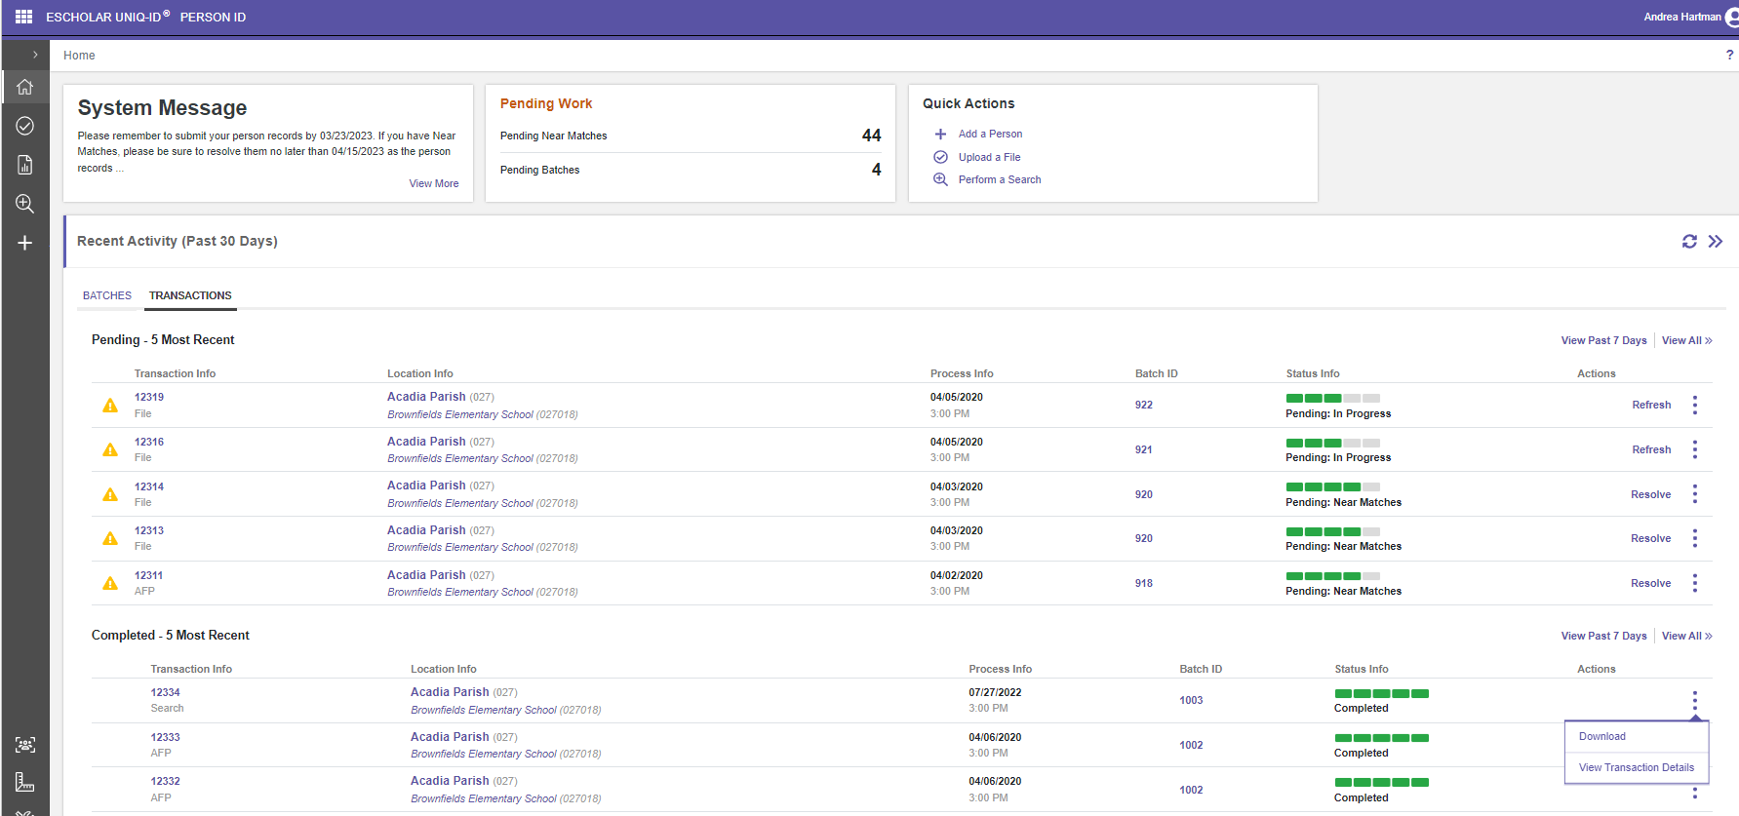
Click view transaction details.
Notes:
Click view transaction details.

Slide 54
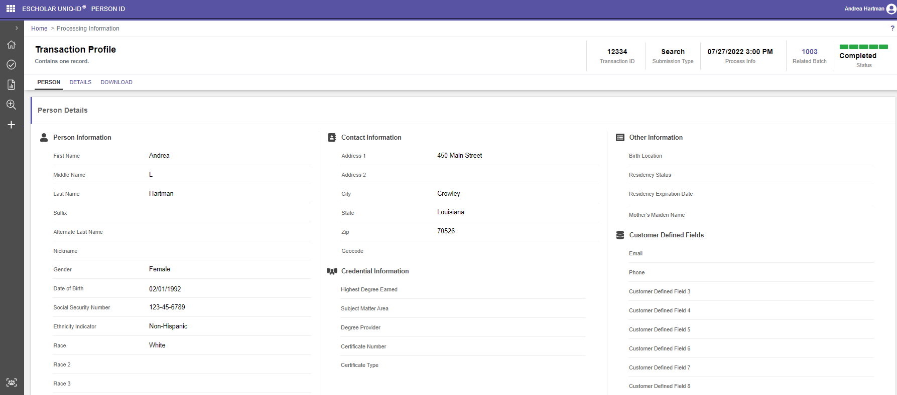
Clicking view transaction details takes the user to the transaction profile for the individual submission record. Click the details tab to see the processing details.
Notes:
Clicking view transaction details takes the user to the transaction profile for the individual submission record.
Click the details tab to see the processing details.

Slide 55
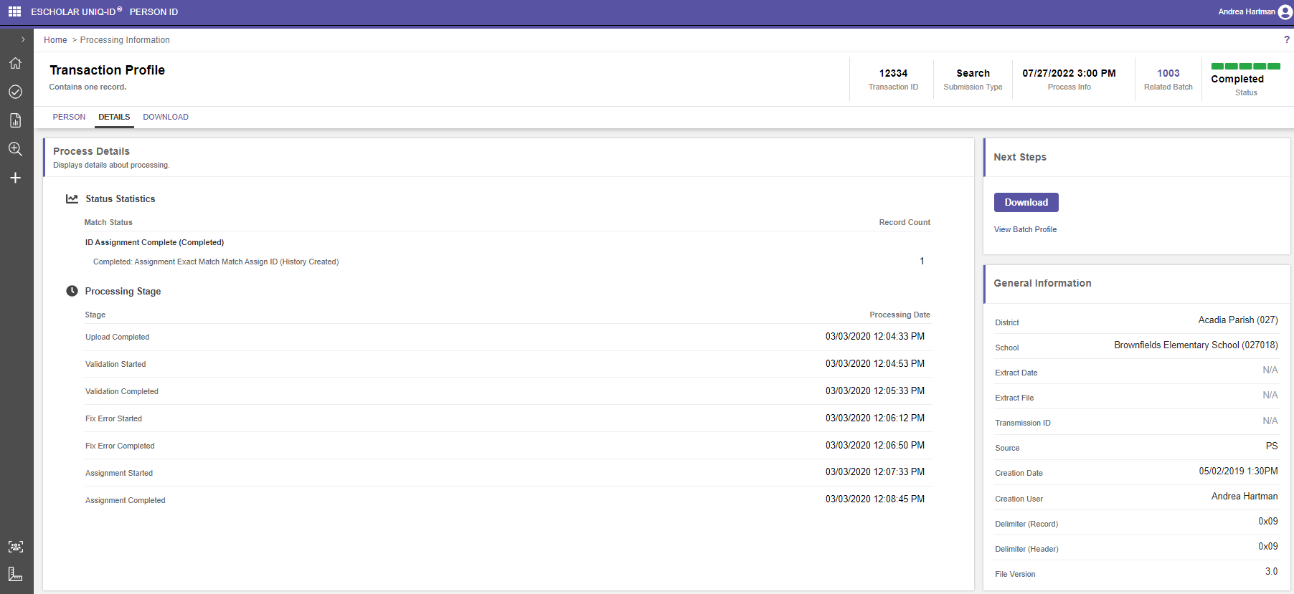
The details tab shows the processing stages of the transaction. The user can download the results by clicking either the download tab or the download button.
Notes:
The details tab shows the processing stages of the transaction. The user can download the results by clicking either the download tab or the download button.

Slide 56
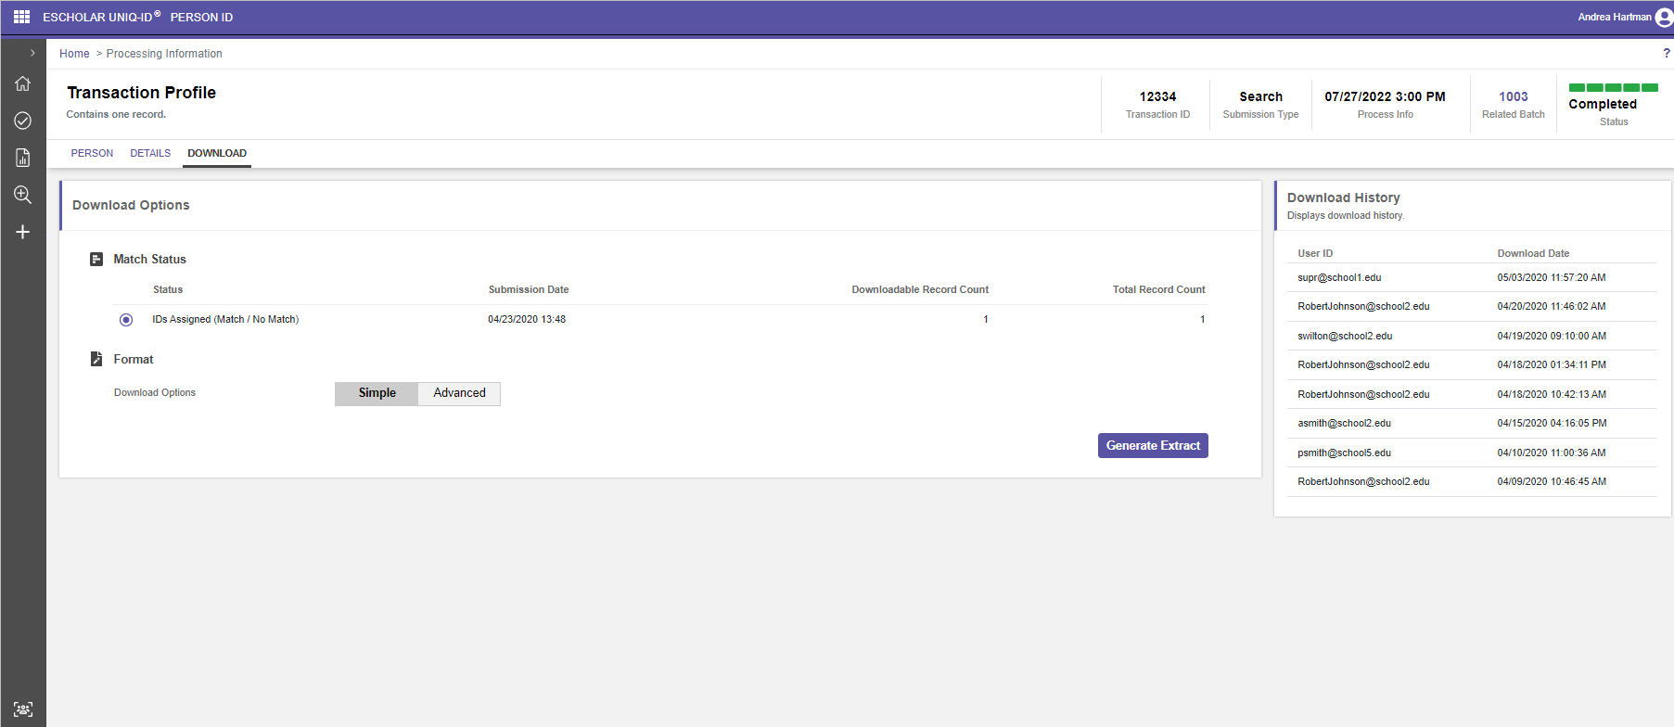
The download tab shows that this transaction was a match, and an ID was assigned. The user can download the results by clicking the Generate Extract button.
Notes:
The download tab shows that this transaction was a match, and an ID was assigned.
The user can download the results by clicking the Generate Extract button.

Slide 57
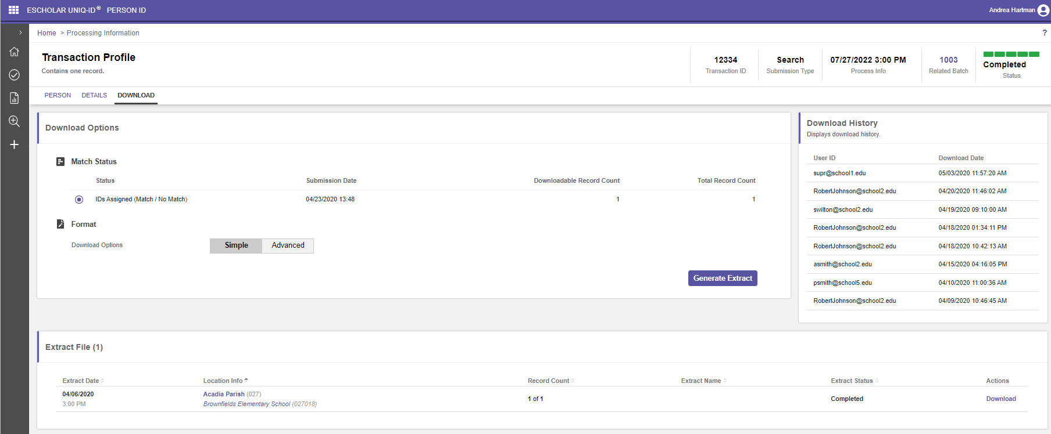
Click the download link.
Downloading an individual transaction allow the user to get results for one transaction before the entire batch has finished processing.
Notes:
Click the download link.
Downloading an individual transaction allow the user to get results for one transaction before the entire batch has finished processing.

Slide 58
SecureID Overview
ID Assignment Process
Near Match Resolution
Match Options and Search Options
Reports and Troubleshooting
Support and Wrap Up
Notes:
Next up, Near Match Resolution.

Slide 59
#3
Near Match Resolution
Notes:
Near Match Resolution.

Slide 60
Near Match Resolution
Notes:
Near Match Resolution

Slide 61
Near Match Resolution
The Matching Process
Near Match Rules
Resolving Near Matches
Notes:
We have navigated through the ID assignment process with no errors.
Next, we will review the matching process in depth.
Then we will look at how near matches are resolved through the application.

Slide 62
Notes:
We’ve already viewed a brief overview of the matching process.
In this next section we will be discussing in more detail the process which the matching engine goes through when a submission record is received by the system.
This is where most of the work being done by the application occurs.

Slide 63
Notes:
During the matching process:
Click
Submission Records are submitted to the system.
Click
Matching engine develops an index of records.
Click
Matching engine compares submission records to the person index records and provides a match score and match decision.

Slide 64
Notes:
During the matching process, the system searches for possible candidates that match the submission record and generates a match score for each of the possible candidates.

Slide 65
Notes:
The Matching Engine uses the last name, first name, birth date and, gender for matching. The middle name will be used if provided. The system then searches the data in the student index using the matching fields.

Slide 66
Notes:
The matching engine accounts for exceptions such as misspellings, nicknames, hyphenated names, spaces, and spellings etc.
This is only a partial list of the exceptions.
The Matching engine employs a variety of different algorithms to catch different name variations.

Slide 67
Notes:
Based upon the search results, the system generates a Match Score for each record. In this example, we can see that Joseph R. Martinez is the closest match to the submission record and is given a match score of 98.

Slide 68
94-100
80-93
0-79
Notes:
After the match score is generated, the system makes a match decision.
The Match decision is determined by comparing the match score to system thresholds.
The thresholds are set as follows:
94-100 is a Match
80-93 is a Near Match
0-79 is no match
The threshold are the same across all person types. (For example: the thresholds do not change between K12 Student, Non-Public and Staff.)

Slide 69
Notes:
The most frequent result will be
Click
no match,
Click
followed by match
Click
and then near match.

Slide 70
Notes:
click
If the system does not find a match, a new ID will be created for the submission record,
click
if the system finds a match, the master record will be updated
click
and if the system finds a near match, the user will need to review the record to determine if the record is a match or not.

Slide 71
Notes:
If the system finds no matching student, it will assign a new ID to the submission record.
These records do not need to be reviewed.
In this example, Jose R. Martinez does not match Josie Martin.
The match score is 65 which is below the match threshold.
Therefore, Jose R. Martinez receives an new ID.

Slide 72
Notes:
If the system finds a Match it assigns the ID of the matching student to the submission record.
If the demographics are different, and the submission record comes from an authoritative source,
the submission record updates the master record.
The previous Master record gets moved to the ID history.

Slide 73
Notes:
In this example names are close but not exact.
The Birthdates are close.
The Match score flags this as a near match.
Since the system can not determine whether these students are the same, this decision will require human intervention to resolve.

Slide 74
Notes:
If two or more potential matches are found above the matching threshold, the system forces a near match. The submission record will reside in the near match state until it is resolved.

Slide 75
Notes:
If the submission record is a match to a master record, and the district is the same, but the local ID is different, the system will force a near match.
The LEA should research why a student has two different local IDs.
If the student’s records in the local SIS are split between two different local IDs,
the LEA will need to resolve the issue in their local system and then complete the near match process.
The system will automatically assign the ID to a candidate that has a matching score of 100.

Slide 76
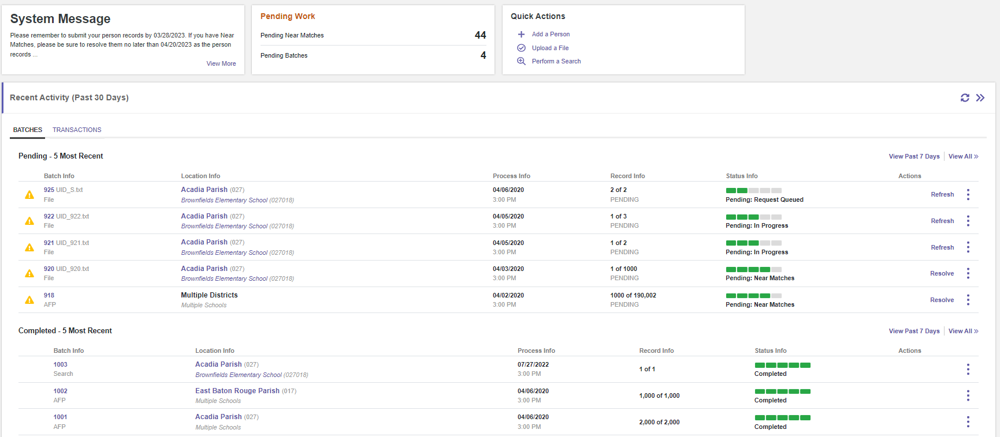
The Status of Batch 920 indicates there are Pending Near Matches. The Next Action is Resolve.
Human intervention required to determine whether the submission record matches the master record.
The user will click the Resolve button.
Notes:
Now let’s look at what resolving near matches looks like in the application.
Here is an example:
The Status of Batch 920 indicates there are Pending Near Matches
The Next Action is Resolve.
Human intervention required to determine whether the submission record matches the master record.
The submission record is viewed side by side with master record in the application to determine the differences.
The user will click the Resolve button.

Slide 77
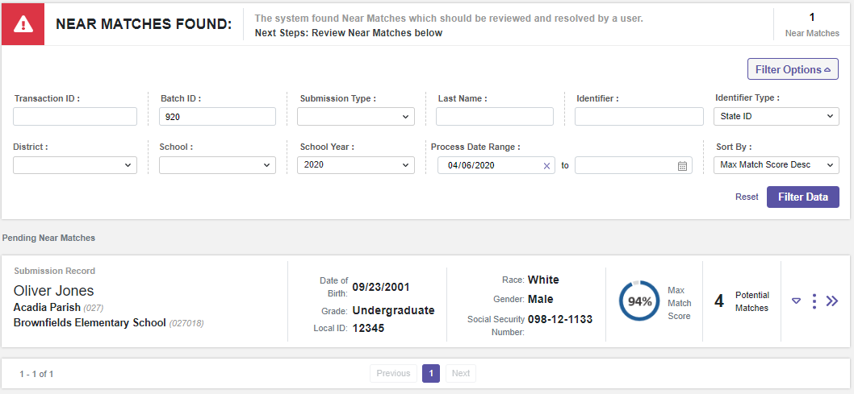
The user lands on the Pending Near Match panel. We can see the Batch ID is 920 and the submission record is Oliver Jones. Oliver has 4 potential near matches.
Notes:
The user lands on the Pending Near Match panel. We can see the Batch ID is 920 and the submission record is Oliver Jones. Oliver has 4 potential near matches.
The user can see a summary of the near match record data by clicking the down arrow or see the entire near match record by clicking the right arrow. Let’s look at both screens.

Slide 78
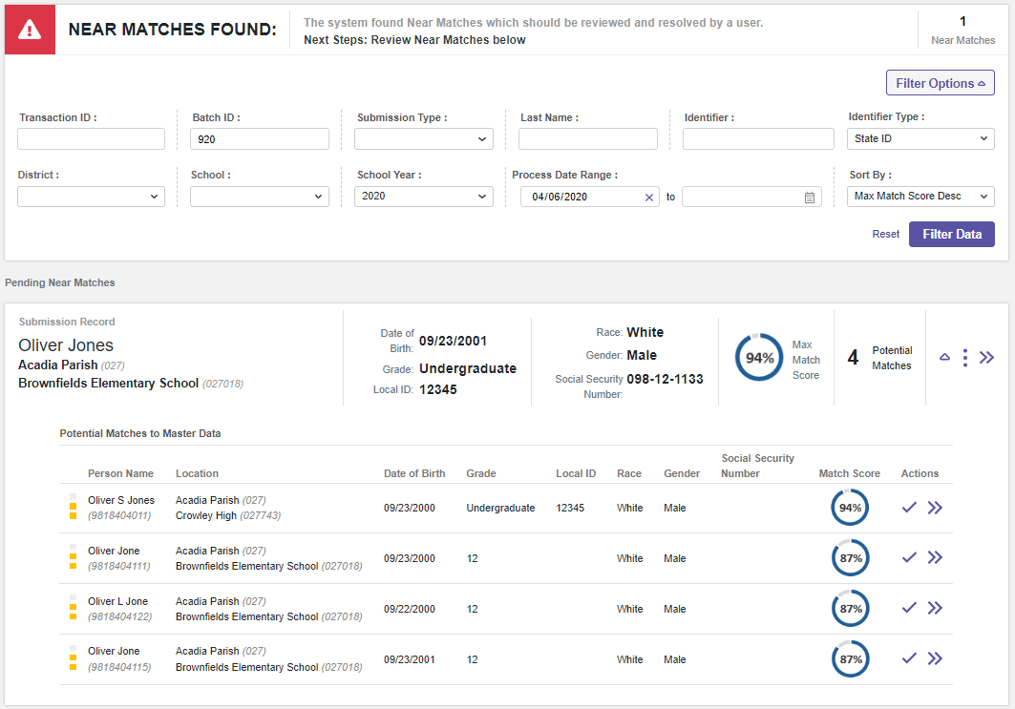
The potential near matches are is highlighted above. To see more information, click the double right arrow.
Notes:
The potential near match is highlighted on this screen shot. To see more information, click the double right arrow.

Slide 79
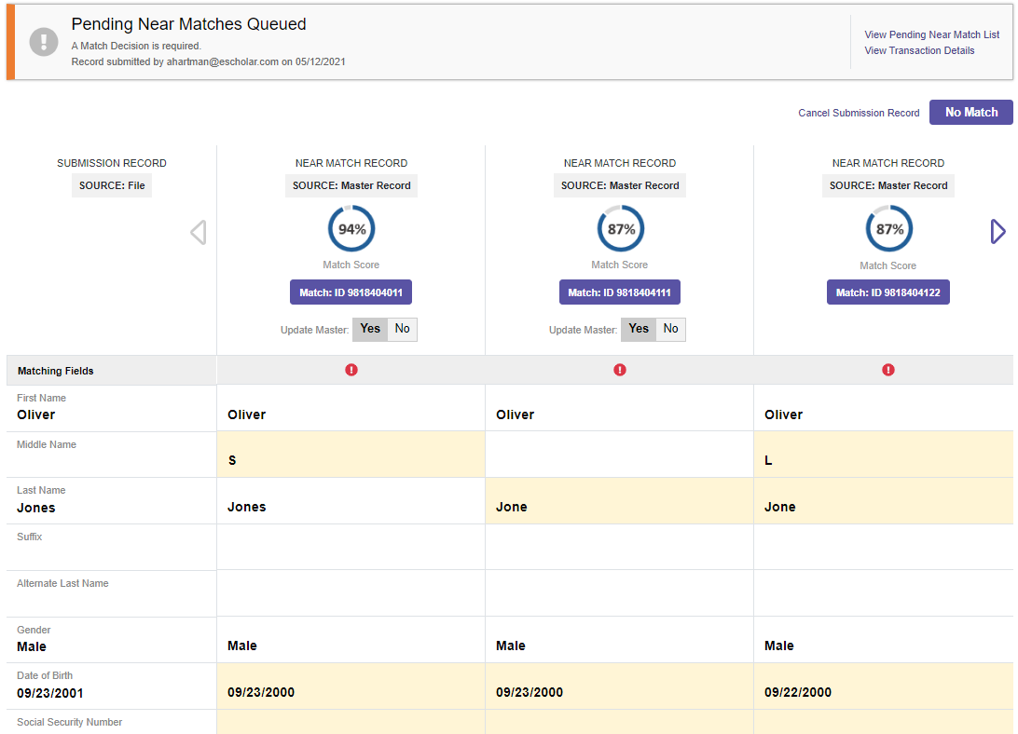
The pending near match columns highlights the data differences.
Notes:
The pending near match columns highlights the data differences.

Slide 80
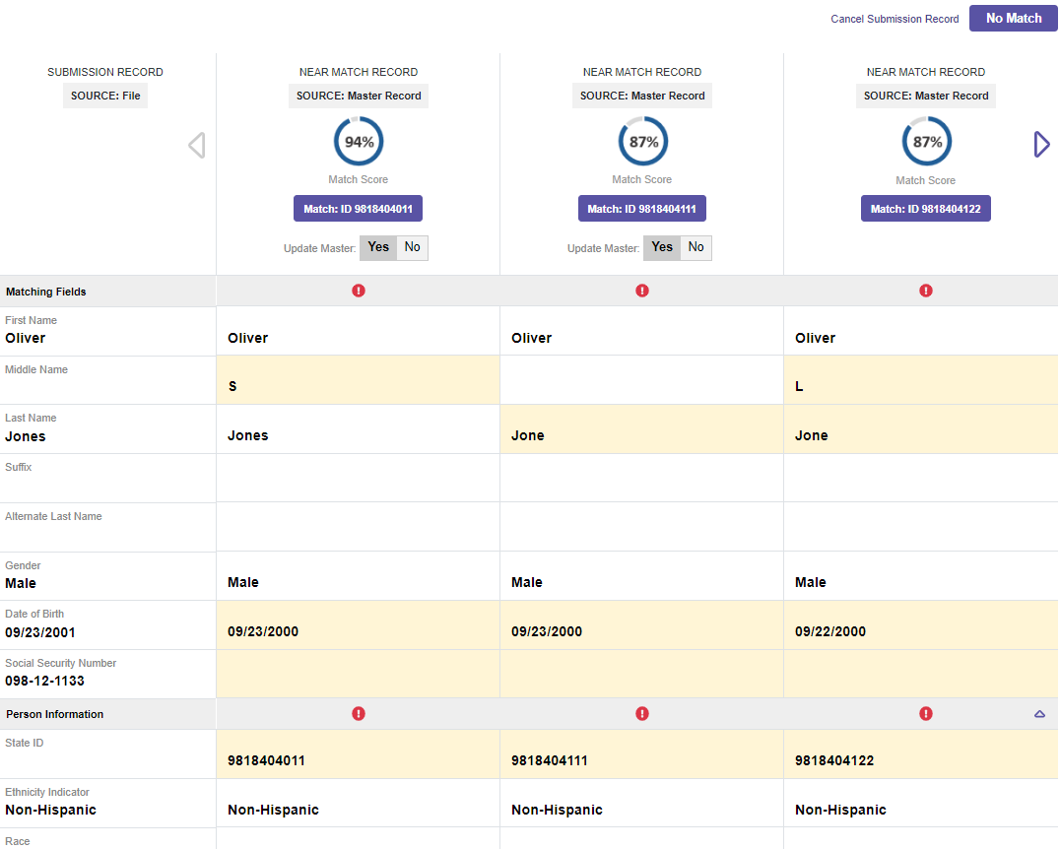
Compare Near Match
The user lands on the Compare Near Match Panel.
The user can compare the submission record with the near match record.
Scroll down the page to see additional data such as the school year, district code, school code, local ID and grade level.
After the user researches the data, the user can select Match ID# or No Match.
The user also could cancel the submission record.
Notes:
The user lands on the Compare Near Match Panel.
The user can compare the submission record with the near match record.
Scroll down the page to see additional data such as the school year, district code, school code, local ID and grade level.
After the user researches the data, the user can select Match ID# or No Match.
The user also could cancel the submission record.

Slide 81
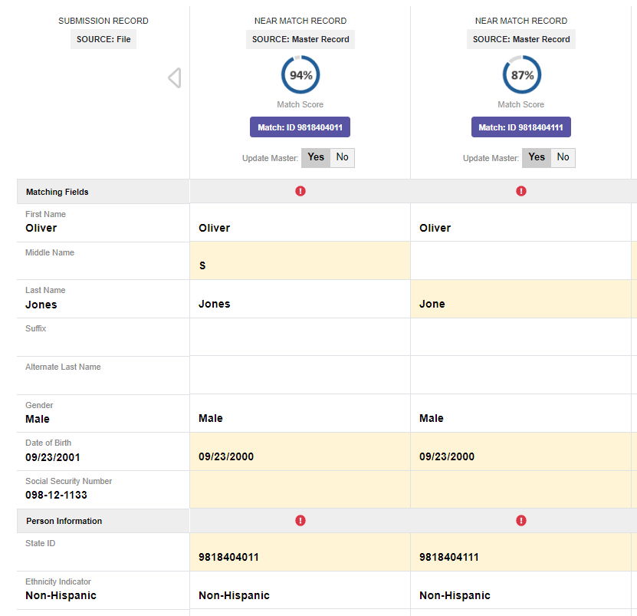
Updating the Master
If the user selects the Match record, the user can choose to update the master record.
If the master record is updated, the submission record data will become the master and the data on the master record will be moved to history.
The user should update the master record if the submission data is the most accurate and recent student data.
Notes:
If the user selects the Match record, the user can choose to update the master record.
If the master record is updated, the submission record data will become the master and the data on the master record will be moved to history.
The user should update the master record if the submission data is the most accurate and recent student data.

Slide 82
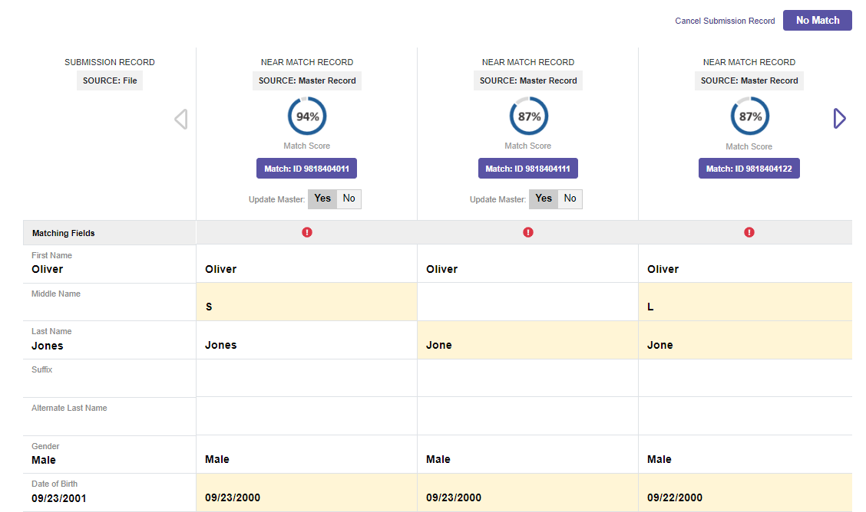
I have decided that the submission record matches the first master record.
Click Match: ID #.
Notes:
I have decided that the submission record matches the first master record.
Click Match: ID #.

Slide 83
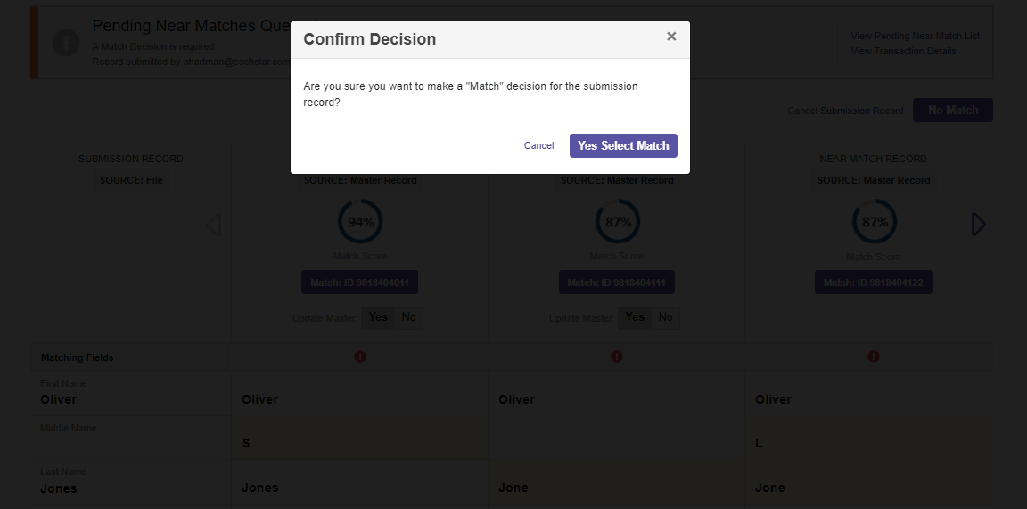
Confirm your decision.
Notes:
Confirm your decision.

Slide 84
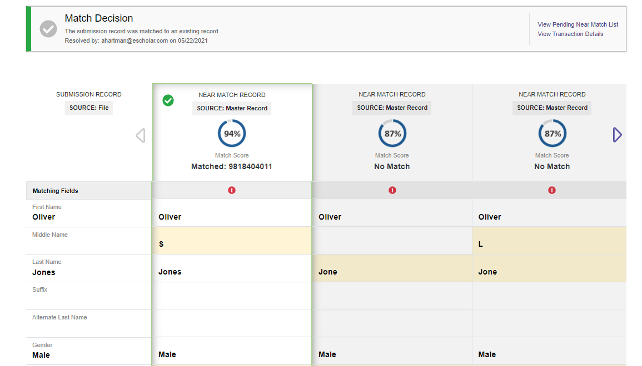
The matched record is highlighted. The other records are no match.
The user can view other pending near matches, transaction details or return to their home screen.
Notes:
The matched record is highlighted. The other records are no match.
The user can view other pending near matches, transaction details or return to their home screen.

Slide 85
Near Match Best Practices
Use demographics found on a birth certificate as the most trusted source before creating a student record and sending the record for ID assignment.
Compare all the data provided in the side-by-side comparison, not just the required fields.
Speak with school staff who know the student(s) involved in the near match.
When near matches happen across districts, and the LEA is unsure of which action to take, first contact the district where the student is currently enrolled to avoid creating duplicate ID’s.
Notes:
Use demographics found on a birth certificate as the most trusted source before creating a student record and sending the record for ID assignment.
Compare all the data provided in the side-by-side comparison, not just the required fields.
Speak with school staff who know the student(s) involved in the near match.
When near matches happen across districts, and the LEA is unsure of which action to take, first contact the district where the student is currently enrolled to avoid creating duplicate ID’s.

Slide 86
Notes:
Let’s take a quick look at Resolving Near Matches in the eScholar Demo site.

Slide 87
Updating the Master Record
What happens when I select “Yes” for the “Update Master” and click the Master: ID# button?
The information contained in the submitted record becomes the record’s current information or Master Record.
  The information of the master record becomes part of that record’s history.
  The default is to update master.
Notes:
Q:
What happens when I select “Yes” for the “Update Master” and click the Master: ID# button?
Click
A:
The information contained in the submitted record becomes the record’s current information or Master Record.
The information of the master record becomes part of that record’s history.
The default is to update master.

Slide 88
Updating the Master Record
What happens when I select “No” for the “Update Master” and click the Match: ID# button?
The submission record will be assigned the matching record’s ID, but the master record will not be updated with the submission record’s information.
Notes:
Q:
What happens when I select “No” for the “Update Master” and click the Match: ID# button?
Click
A:
The submission record will be assigned the matching record’s ID, but the master record will not be updated with the submission record’s information.

Slide 89
Downloading IDs

Slide 90
Downloading IDs
Downloading by Batch Profile
Downloading by Location Profile
Notes:
Let’s look at downloading IDs by batch and by location.

Slide 91
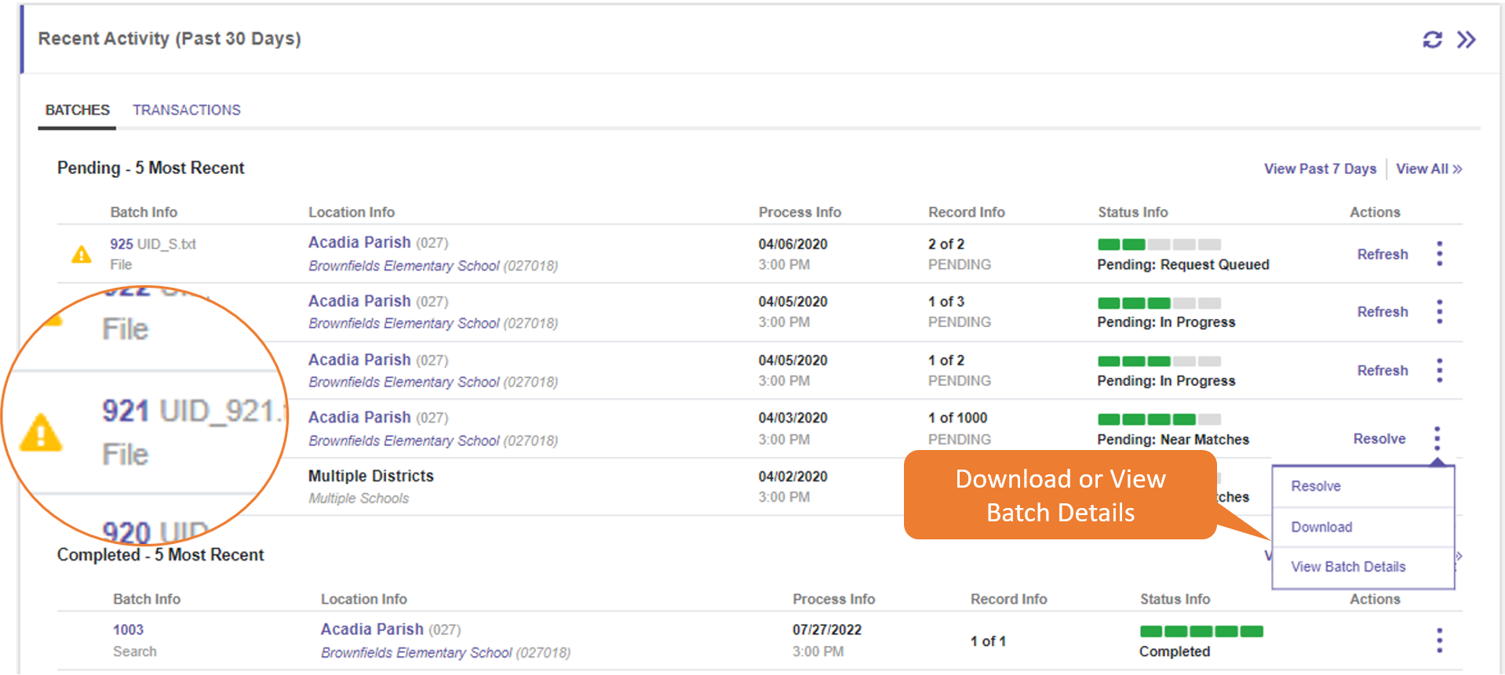
Downloading by Batch Profile
Notes:
On the Dashboard, click on the Batch tab on the Recent Activity panel.
Click on the Batch Info number under Batch Info column
or click the Download or View Batch Details link in the multiple select action icon menu.

Slide 92
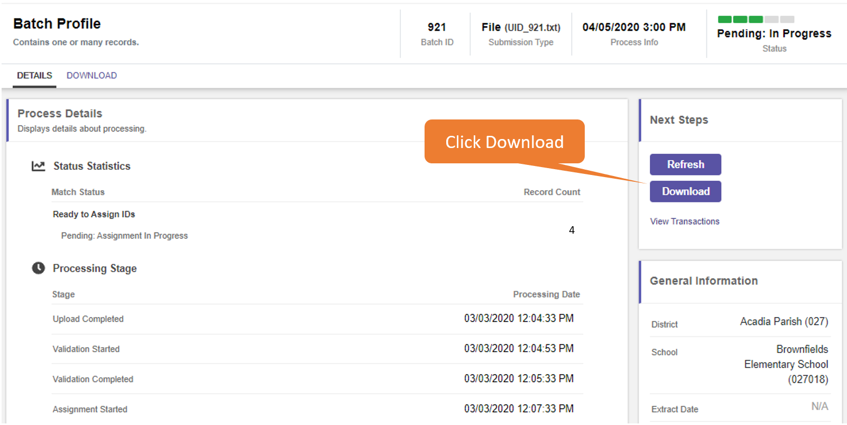
The application will display the selected Batch Profile. Click Download.
Notes:
The application will display the selected Batch Profile.
Click Download.

Slide 93
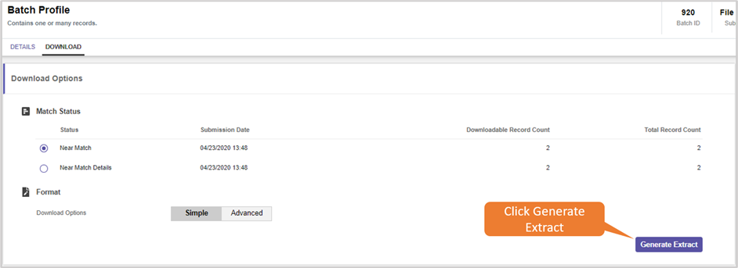
Click Generate Extract.
Notes:
Click Generate Extract.

Slide 94

Click Download under Actions.
Notes:
Click Download under Actions.

Slide 95
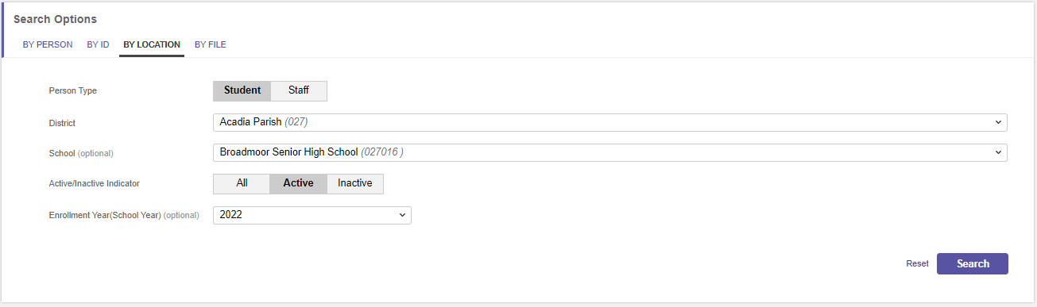
Downloading by Location Profile
Notes:
Click on the Search icon on the side navigation panel.
Click By Location.
Select the District and School if desired. Users will only see the District and Schools for which they are authorized to view data.
Click Search.

Slide 96
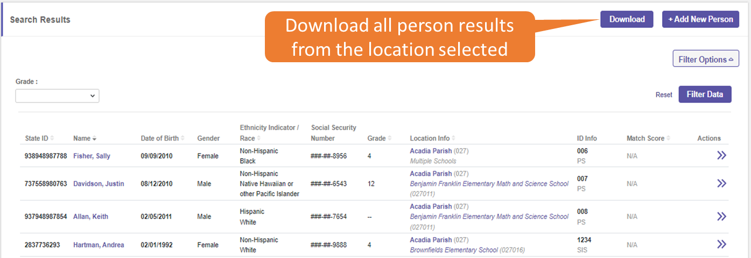
The Search results will be displayed. Click Download.
Notes:
The Search results will be displayed.
Click Download.

Slide 97
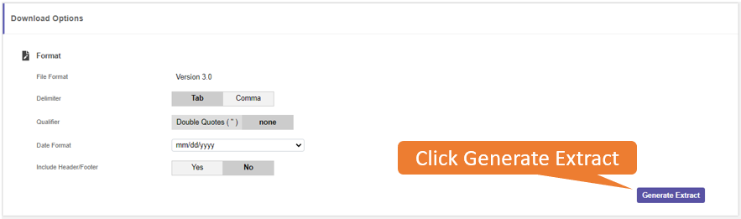
Click Generate Extract.
Notes:
Click Generate Extract.

Slide 98
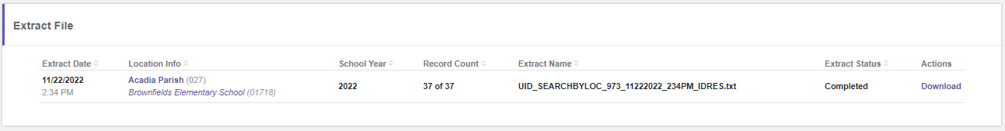
Click Download.
Notes:
Click Download.
The user will download all the records for the selected location for the current school year.

Slide 99
Duplicate and Shared IDs
Notes:
Duplicate and Shared IDs

Slide 100
Consequences of Erroneous Match Decisions
Duplicate IDs
  One student has more than one SecureID.
Shared IDs
  Two students share one Secure ID.
Notes:
Duplicate IDs
One student has more than one SecureID.
Shared IDs
Two students share one Secure ID.

Slide 101
Duplicate IDs
  Duplicate IDs are created when a student is mistakenly assigned two or more Unique IDs.
  Sometimes created by selecting ‘Create New ID’ when the user should have selected ‘Assign Selected’.
  When one student has more than one Unique ID the data is split between the two records when it should be assigned to only one record.
Notes:
Duplicate IDs are created when a student is mistakenly assigned two or more Unique IDs.
Sometimes created by selecting ‘Create New ID’ when the user should have selected ‘Assign Selected’.
When one student has more than one Unique ID the data is split between the two records when it should be assigned to only one record.

Slide 102
Notes:
Duplicate IDs are created when a student is mistakenly assigned two or more Unique IDs.
This can occur if the user assigns a new ID instead of identifying the correct near match record.
When one student has more than one Unique ID the data is split between the two records when it should be assigned to only one record.
The resolution is to Retire one of the IDs and move the data to history.

Slide 103
Shared IDs
Shared IDs
  A Shared ID occurs when two separate students are both using the same ID.
  Sometimes created by selecting ‘Assign Selected’ when the user should have selected ‘Create New ID’.
  This can occur when a user assigns a near match record that belongs to a different student.
Notes:
A Shared ID occurs when two separate students are both using the same ID.
Sometimes created by selecting ‘Assign Selected’ when the user should have selected ‘Create New ID’.
This can occur when a user assigns a near match record that belongs to a different student.

Slide 104
Notes:
A Shared ID occurs when two separate students are both using the same ID.
This can occur when a user assigns a near match record that belongs to a different student.
Resolution: Split IDs.

Slide 105
SecureID Overview
ID Assignment Process
Near Match Resolution
Match Options and Search Options
Reports and Troubleshooting
Support and Wrap Up
Notes:
Match Options and Search Options

Slide 106
#4
Match Options and Search Options
Notes:
Match Options and Search Options

Slide 107
Match Options
Notes:
First let’s look at Match Options.

Slide 108
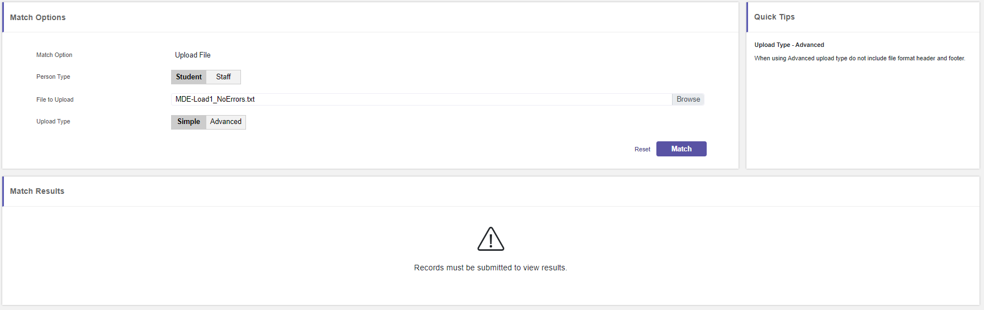
Choose Match Options from the main menu.
Browse and select a file to upload for match options.
Choose simple upload type. Click Match.
Notes:
Choose Match Options from the main menu.
Browse and select a file to upload for match options.
Choose simple upload type. Click Match.

Slide 109
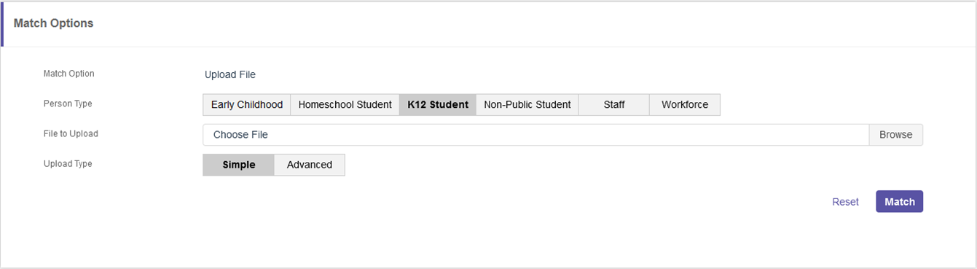
The user must upload a file that matches the person type selected.
Remember, it is a good idea to have the person type in the file name.
Once you have selected the file to upload, click match.
Notes:
If the user has access to multiple Person Types, as shown on this screen shot, the user must select the Person Type that matches the file the user wishes to upload and match. The system will only search within the person type selected.
Remember, it is a good idea to have the person type in the file name.
If a user only has access to one Person Type, the system will search only the person type the user has access to.
Once you have selected the file, click match.

Slide 110
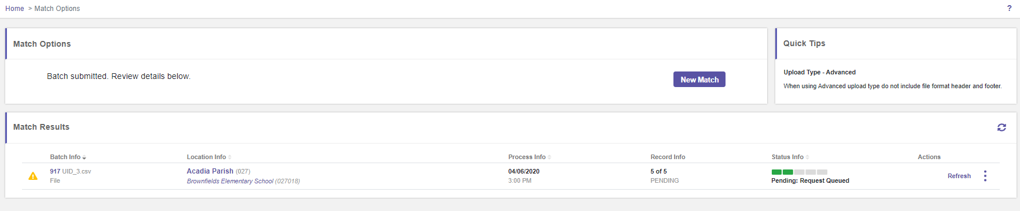
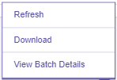
The match results will return a batch.
Click the action icon to Refresh the status or click Download or View Batch Details.
Let’s click View Batch Details.
Notes:
The match results will return a batch.
Click the action icon to Refresh the status or click Download or View Batch Details.
Let’s click View Batch Details.

Slide 111
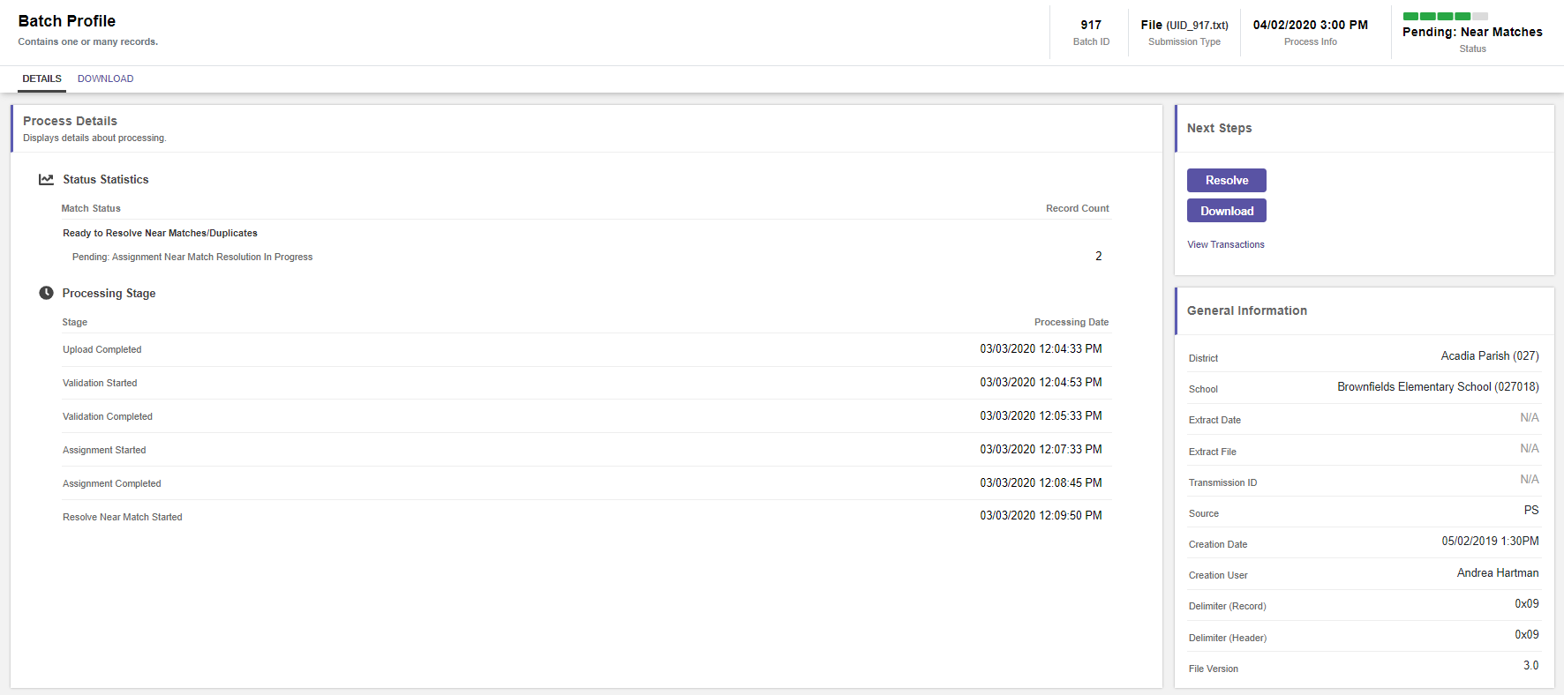
Clicking View Batch Details brings the user to the Batch Profile panel.
The user can view the processing details or download the results.
First, let’s view Download then we will look at View Transactions. Click Download.
Notes:
Clicking View Batch Details brings the user to the Batch Profile panel.
The user can view the processing details or download the results.
First, let’s view Download then we will look at View Transactions.
Click Download.

Slide 112
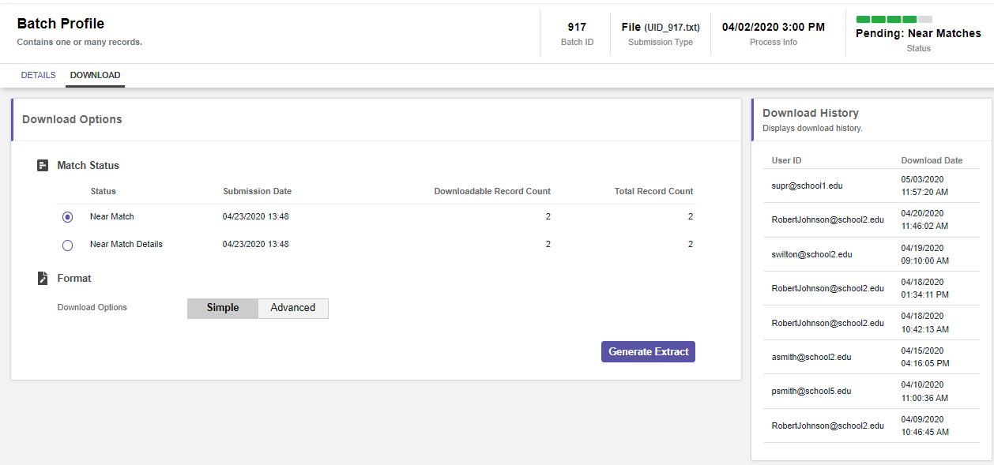
To Download the file, click Generate Extract.
Notes:
To Download the file, click Generate Extract.

Slide 113
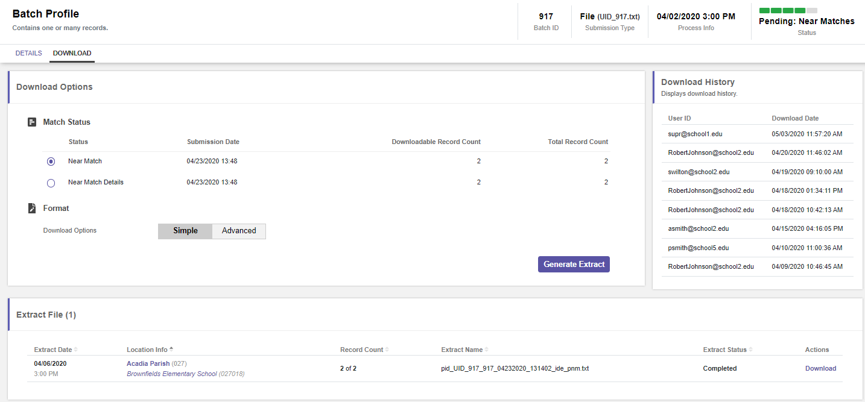
Click Download.
Notes:
Click Download

Slide 114
Now let’s View Transactions for the same batch file (917).
Click View Transactions.
Notes:
Now let’s View Transactions for the same batch file (917).
Click View Transactions.

Slide 115
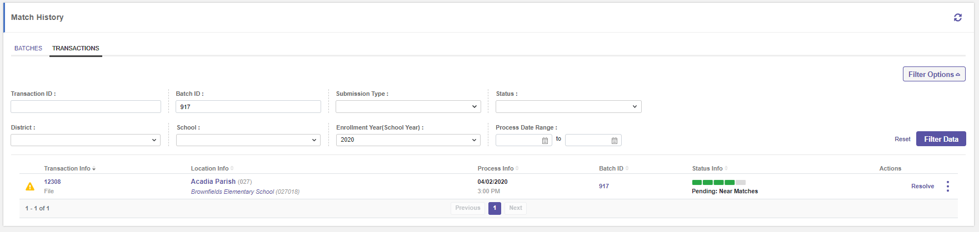
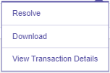
Clicking View Transactions Details brings the user to the match history transaction page.
The user can filter the data, resolve near matches, view the Transaction Profile or download the results.
Click View Transaction Details.
Notes:
Clicking View Transactions brings the user to the match history transaction page.
The user can filter the data, resolve near matches, view the Transaction Profile or download the results.
Click View Transaction Details.

Slide 116
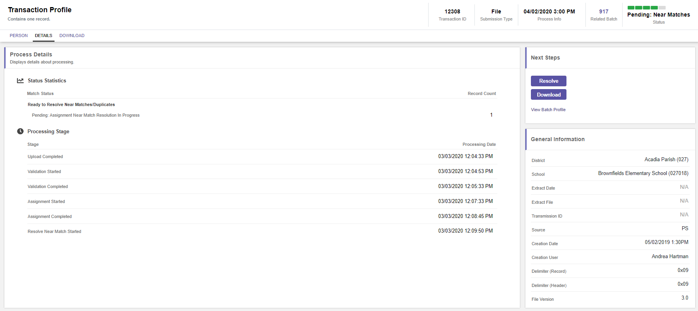
On the Transaction Profile panel, the user can view the status statistics,
the processing stage and the general information related to the transaction.
The user can also download the transaction results.
Notes:
On the Transaction Profile panel, the user can view the status statistics,
the processing stage and the general information related to the transaction.
The user can also download the transaction results.

Slide 117
Search Options
Notes:
Search Options

Slide 118
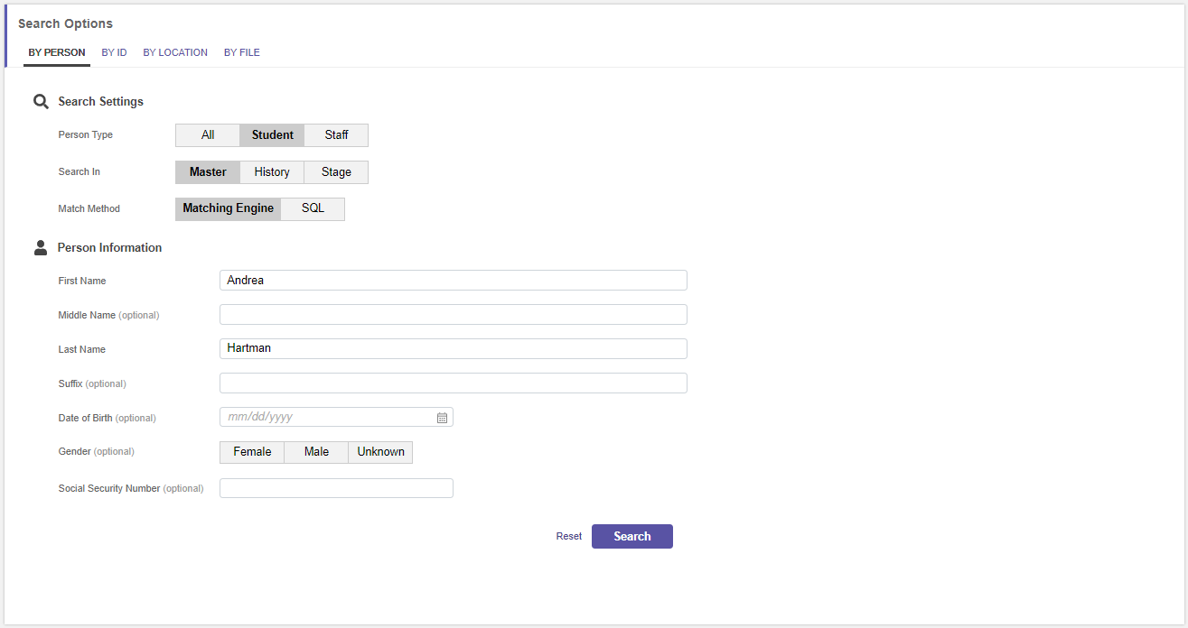
On the main menu, click Search. On the search options panel, there are four ways to search: By Person, By ID, By Location or By File.
In this case we are searching for Andrea Hartman.
Notes:
On the main menu, click Search.
On the search options panel, there are four ways to search:
By Person, By ID, By Location or By File.
In this case we are searching for Andrea Hartman.

Slide 119
Search Options: By Person
Notes:
Search Options

Slide 120
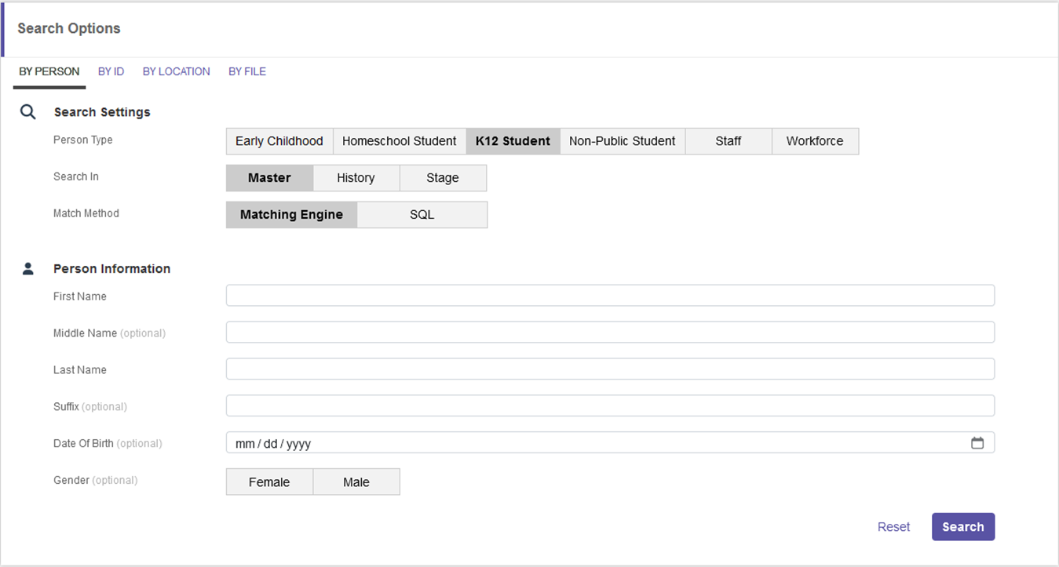
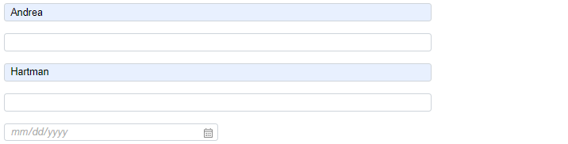
Search Options will only search in the person type selected.
We have selected K12 Student and entered Andrea Hartman. Click Search.
Notes:
If the user has access to multiple Person Types, as shown on this screen shot, the user must select the Person Type that matches the person name the user wishes to match. The system will only search within the person type selected.
If a user only has access to one Person Type, the system will search only the person type the user has access to.
We have selected K12 Student and entered Andrea Hartman. Click Search.

Slide 121
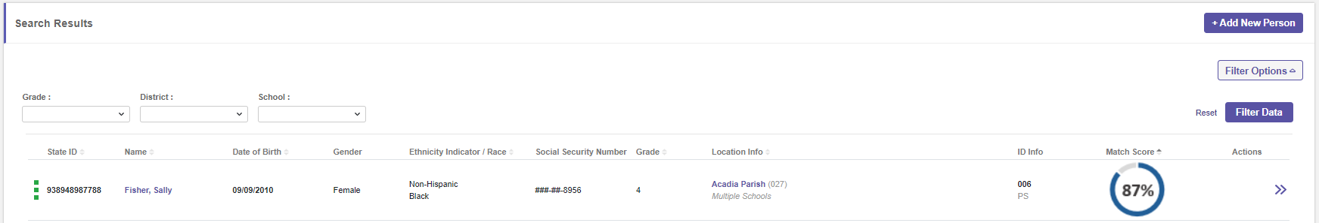
The system returned the matching results.
Drill into the result by clicking the icon under Actions.
Notes:
The system returned the matching results.
Drill into the result by clicking the icon under Actions.

Slide 122
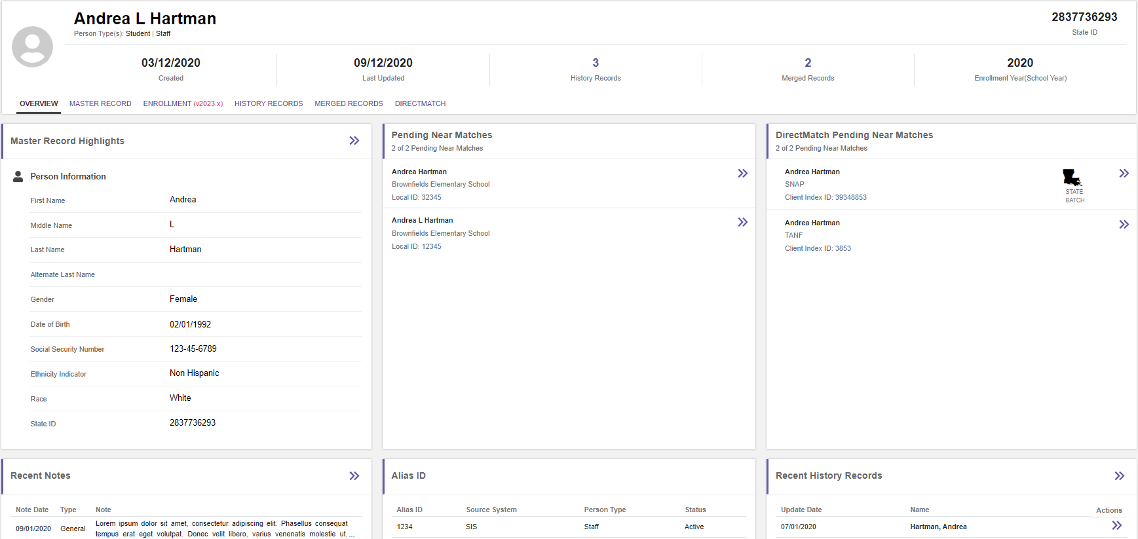
The user lands on the Person Profile. The user can view the Overview, Master Record, Enrollment Information, History Records, Merged Records and Direct Match records if applicable.
Notes:
The user lands on the Person Profile.
The user can view the Overview, Master Record,
Enrollment Information, History Records,
Merged Records and Direct Match records if applicable.

Slide 123
The overview tab contains demographic information, pending near matches, recent notes, alias IDs and recent history records.
Notes:
The overview tab contains demographic information,
pending near matches, recent notes,
alias IDs and recent history records.

Slide 124
Search Options: By ID
Notes:
Search Options

Slide 125


Click by ID to search by State ID or Local ID.
Remember, Search Options will only search and return results for the person type selected.
Enter the ID and click Search.
Notes:
Click by ID to search by State ID or Local ID.
Remember, Search Options will only search and return results for the person type selected.
Enter the ID and click Search.

Slide 126

Drill into the results to see the person profile.
Notes:
Drill into the results to see the person profile.

Slide 127
Search Options: By Location
Notes:
Search Options

Slide 128

Click By Location to search for a location. Select the district and school. The district and school options will be limited by the user’s data security.
Notes:
Click By Location to search for a location. Select the district and school. The district and school options will be limited by the user’s data security.

Slide 129
When searching By Location the system will only search for the selected Person Type if the user has access to more than one person type.
Click Search.
Notes:
When searching By Location the system will only search for the selected Person Type if the user has access to more than one person type.
Users who have access to only one person type will not see the person type selection displayed.
Click Search.

Slide 130

The user will see the student data for the location selected. The user can download all the student records for the location and the current school year.
Click Download.
Notes:
The user will see the student data for the location selected. The user can download all the student records for the location and the current school year.
Click Download.

Slide 131
Search Options: By File
Notes:
Search Options: By File

Slide 132

Click by File to search by a file. Click browse and select the file to upload. The user must upload a file that contains the same type of data as the selected person type. The file naming convention we talked about earlier tells the user if the file is a Student or Staff file. Click Search.
Notes:
Click by File to search by a file.
Click browse and select the file to upload.
The user must upload a file that contains the same type of data as the selected person type. The file naming convention we talked about earlier tells the user if the file is a Student or Staff file.
Click Search.

Slide 133

The system will return the matching batch. Click the Batch Number on the left side of the screen.
Notes:
The system will return the matching batch.
Click the Batch Number on the left side of the screen.

Slide 134

Clicking the Batch number takes the user to the Batch profile. The user can view the batch status, view transactions or download the batch records from this page.
Notes:
Clicking the Batch number takes the user to the Batch profile.
The user can view the batch status, view transactions
or download the batch records from this page.

Slide 135
SecureID Overview
ID Assignment Process
Near Match Resolution
Match Options and Search Options
Reports and Troubleshooting
Support and Wrap Up
Notes:
Reports and Troubleshooting

Slide 136
#5
Reports and Troubleshooting
Notes:
Reports and Troubleshooting

Slide 137
Reports
Notes:
Reports

Slide 138

Click on the Reports Icon on the Main Menu to see the report options.
Notes:
Click on the Reports Icon on the Main Menu to see the report options.
Reports are visible if the user’s role has permissions to see reports.
Data in the Reports is dependent upon the user’s security access.

Slide 139
Troubleshooting
Notes:
Troubleshooting

Slide 140
Troubleshooting Topics
File Validation Issues
Data Validation Errors
Located rejected files
Notes:
In this section, we will look at
File validation issues
Data validation issues
And locating rejected files.

Slide 141
Notes:
File validations take place in step #2 of the ID Assignment process.

Slide 142
File Validation Issues
Rejection of a Student Batch File will occur if:
  1+ record types are missing.
  1+ fields have been omitted from a record.
  The “Number of Records” field in the trailer record is incorrect.
  Transmission ID in header and trailer records don’t match.
  Maximum # of allowable detail record errors has been exceeded.
Notes:
Rejection of a Student Batch File will occur if:
1+ record types are missing.
1+ fields have been omitted from a record.
The “Number of Records” field in the trailer record is incorrect.
Transmission ID in header and trailer records don’t match.
Maximum # of allowable detail record errors has been exceeded.

Slide 143

This example shows the missing record type TT. The file will be rejected because it must contain all three of the record types: TH (Header), ID (Detail) and TT (Trailer).
Notes:
This example shows the missing record type TT.
The file will be rejected because it must contain all three of the record types:
TH (Header), ID (Detail) and TT (Trailer).

Slide 144

If the entire field is missing in one or more rows the file will be rejected.
In this case Mr. DeJesus’ first name is missing.
Notes:
If the entire field is missing in one or more rows the file will be rejected. In this case Mr. DeJesus’ first name is missing.

Slide 145

The “Number of Records” field in the Trailer Record is incorrect.
  This number should be the sum of all the records in the file, including the Header and Trailer Records.
Notes:
The “Number of Records” field in the Trailer Record is incorrect.
This number should be the sum of all the records in the file, including the Header and Trailer Records.

Slide 146

The Transmission ID in the Header and Trailer Records does not match. In the file shown, the ID is 0071262134 in the Header and 0088888888 in the Trailer.
Notes:
The Transmission ID in the Header and Trailer Records does not match.
In the file shown, the ID is 0071262134 in the Header and 0088888888 in the Trailer.

Slide 147
Notes:
We just reviewed some of the common errors that you might receive during the file validation process.
These errors occur most often when a user edits a file manually for resubmission.
Now let’s explore some of the errors that you might receive during the data validation process.

Slide 148
Data Validation Examples
Data Validation process checks to ensure:
  Dates are correct
  Codes are valid
  Data is in the expected format
Notes:
Data Validation process checks to ensure:
Dates are correct
Codes are valid
Data is in the expected format

Slide 149
Canceled Records
Files with canceled records can be downloaded from the Batch Profile.
Click on the batch number and click download.
The downloaded file will contain the reasons the records were canceled.
Notes:
Files with canceled records can be downloaded from the Batch Profile.
Click on the batch number and click download.
The downloaded file will contain the reasons the records were canceled.

Slide 150
SecureID Overview
ID Assignment Process
Near Match Resolution
Match Options and Search Options
Reports and Troubleshooting
Support and Wrap Up

Slide 151
#6
Support and Wrap Up
Notes:
Support and Wrap Up

Slide 152
Notes:
The Support Process

Slide 154
https://secureid.ldoe.la.gov/uid/login
Notes:
Production URL

Slide 155
Notes:
Survey in Webinar software or Survey Monkey.

Slide 156
Notes:
Thank you for your time.

