Slide 1
New Mexico Staff IDentification System
Staff ID
Louisiana Department of Education and eScholar Present:
Staff ID Training for End Users
Staff ID New user training
Notes:
Good Afternoon. Welcome to the Louisiana Dept of Education Staff ID Webinar hosted by LDOE and eScholar.
My name is Elaine Rulla and I will be your host for the presentation.
From LDOE, Sherry and Jayanthi are with us.
Our goal this morning is to introduce you to the Staff ID system. We will be recording today’s webinar in case others are interested in viewing this session.
I see we are about ready to get started. Just a few logistics before we begin: You are currently muted. If you wish to ask a question, please type it in the Q&A box. Take a moment and locate the Q&A box on your device. Since we have a large group attending today, we likely will answer most questions in a follow-up email post webinar.
After today’s webinar you will receive a copy of this slide deck as well as the Q&A document in a follow-up email.
Also, during the webinar, I will periodically ask you to respond to Poll questions. You will be able to answer the questions by clicking directly on your computer screen or your device.
Finally, we will be recording this webinar for your convenience.
Ok. Let’s get started. (To slide deck….)

Slide 2
Session Agenda
Staff ID Overview
ID Assignment Process
Near Match Resolution
Troubleshooting Validation Issues
System Tools
Support and Resources
01
02
03
04
05
06
Notes:
During today’s training session we will cover:
Staff ID Overview
ID Assignment Process
Near Match Resolution
Troubleshooting Validation Issues
System Tools
and
Support and Resources

Slide 3
Course Learning Objectives
Participants will be able to:
Assign Staff IDs in the Staff ID system (Staff ID).
Upload a file of staff records to submit to Staff ID.
Use the Louisiana Secure ID application to resolve near matches.
Describe the criteria used by Louisiana Secure ID in the matching process.
Download a file of staff records, including new IDs from Louisiana Secure ID .
Notes:
At the end of today’s session, participants will be able to:
Assign Staff IDs in the unique ID system (UID), called Louisiana Secure ID.
Upload a file of staff records to submit to Louisiana Secure ID.
Use the Louisiana Secure ID application to resolve near matches.
Describe the criteria used by Louisiana Secure ID in the matching process.
Download a file of student records, including new IDs, from Louisiana Secure ID.

Slide 4
Session Agenda
Staff ID Overview
ID Assignment Process
Near Match Resolution
Troubleshooting Validation Issues
System Tools
Support and Resources
01
02
03
04
05
06
Notes:
Let’s look at the Staff ID Overview.

Slide 5
01
Staff ID Overview
Notes:
Staff ID Overview

Slide 6
eScholar Staff ID Overview: Topics
Key Terms
Overview of ID Assignment Process
Overview of Matching Process
Notes:
The Topics in this section include:
Key Terms
Overview of ID Assignment Process
Overview of Matching Process

Slide 7
Key Terms
Master Record – The current active record in the repository which is used for matching.
Submission Record or Input Record– A record submitted to be matched against the master records.
Staff ID – the ID that is assigned by the Staff ID system.
Notes:
Key Terms
Master Record – The current active record in the repository which is used for matching.
Submission Record or Input Record– A record submitted to be matched against the master records.
Staff ID – the ID that is assigned by the Staff ID system.

Slide 8
Key Terms
Batch – A group of submission records submitted to the system at the same time which are stored as unique entries and can be referred back to by Batch Number. A batch can consist of a single submission record or many submission records.
Match Threshold – Values set by the system administrator that determine the Match, Near Match and No Match scores.
Notes:
Batch – A group of submission records submitted to the system at the same time which are stored as unique entries and can be referred back to by Batch Number. A batch can consist of a single submission record or many submission records.
Match Threshold – Values set by the system administrator that determine the Match, Near Match and No Match scores.

Slide 9
Please note: All data displayed throughout this presentation and in the supporting resources is not real data.
Notes:
Please note that: All data displayed throughout this presentation and in the supporting resources is not real data.

Slide 10
What Does Staff ID do?
Creates and assigns new IDs for Staff memberss who do not have one.
Finds an existing ID for Staff members who already have one.
“Assigns” a new or existing ID to a Staff record in an output file, so it can be consumed by other systems.
Notes:
What does Staff ID do?
Creates and assigns new IDs for Staff members who do not have one.
Finds an existing ID for Staff members who already have one.
“Assigns” a new or existing ID to a Staff record in an output file, so it can be consumed by other systems.

Slide 11
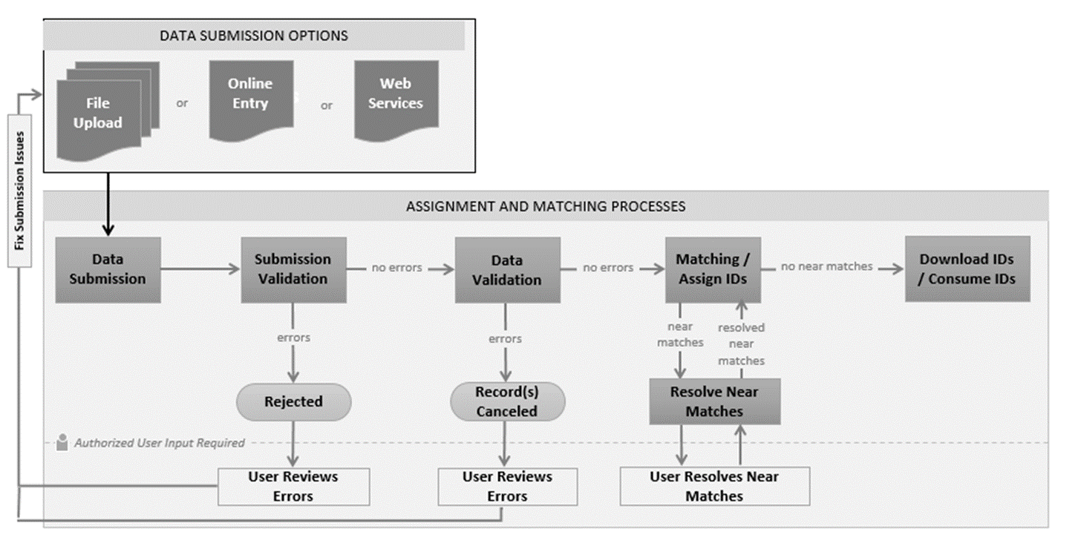
ID Assignment Process: Overview
Notes:
Overview of ID assignment process
Let’s go through each step in more detail

Slide 12
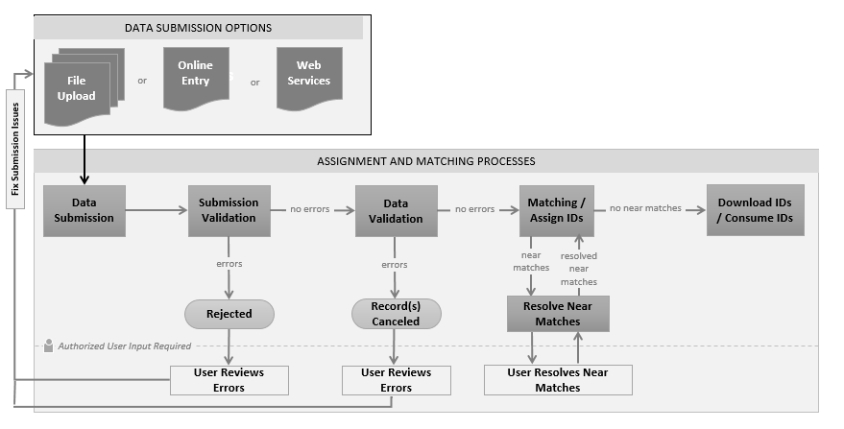
ID Assignment Process: Data Submission
Notes:
First step in the process is to submit student records to UID in a batch file
A standardized file format is submitted to the system for matching via one of the following methods:
Batch Upload – an upload of a file with one or many students within the application
Online entry - this is an upload where the data is entered on line
or
Web services – where the data is retrieved automatically
All submissions are based upon user role and authorization.

Slide 13
ID Assignment Process: File Validation
Notes:
After the file is submitted it goes through a validation process.
This requires no human intervention as long as the file successfully passes validation.
During file validation The system performs a review for issues with the batch file format and layout.
The format of the file is checked against the eScholar required file format to make sure that the correct number of fields exist in the file and that there is a header record and trailer record if these are required.
Results from the file validation process are File Upload Errors or File Upload No Errors.
If the file upload had errors then the file is rejected by the system and has to be fixed and resubmitted

Slide 14
ID Assignment Process: Data Validation
Notes:
Files that are successfully validated are passed along for data validation.
During data validation the data is checked for items such as valid dates and codes.
Again, if the data in the file passes validation then the file is passed along to the matching engine.
If the system was configured to automatically validate data this process would happen without user intervention
If the data fails validation then all errors must be fixed before the file can be submitted for ID assignment.

Slide 15
ID Assignment Process: Assign IDs
Notes:
Files that successfully pass data validation begin the assign ID process.
This is the point at which the data is submitted to the matching engine.
At this stage, the submission records are compared with existing master records.
There are three possible outcomes from the matching engine:
there is no match for the record and a new ID will be assigned,
there is an exact match found and an existing ID will be assigned to the submission record,
or there are near matches identified and human intervention is required.

Slide 16
ID Assignment Process: Download IDs
Notes:
After every submission record has an ID assigned then the user is able to download IDs in a file.

Slide 17
ID Assignment Process: Resolve Near Matches
Notes:
As we noted before, If the matching engine finds near matches then the user must resolve these near matches before the IDs can be assigned and downloaded.

Slide 18
ID Assignment Process: Near Matches Resolved
Notes:
After near matches are resolved then IDs can be assigned and the new IDs downloaded.

Slide 19
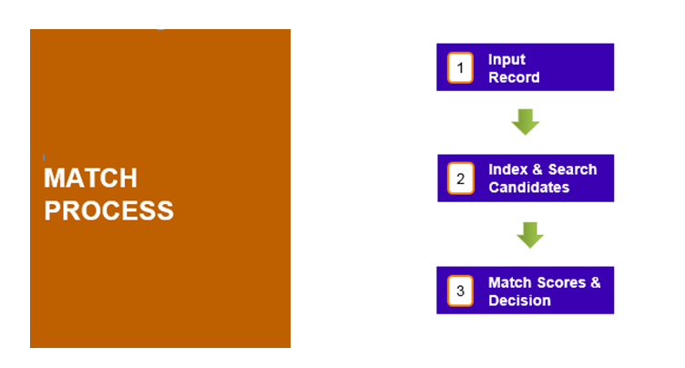
Overview of the Matching Process
Records are submitted.
Matching engine develops an index of candidate records.
Matching engine compares submitted records to index and provides a match decision.
Notes:
First, Records are submitted to the system. We will refer to these records as ‘Input Records’ or ‘Submission Records’ in this presentation.
Next, the Matching engine develops an index of records.
The Matching engine compares the records and provides a match decision.

Slide 20
Outcomes of the Staff ID Matching Process
Near Match
Match
No Match
The most frequent result will be no match, followed by match.
Historically, less than 3% of records will be returned as a near match.
Notes:
In the Staff ID matching process there are 3 possible outcomes as shown here:
Match, No Match and Near Match.
The most frequent result will be no match, followed by match. Historically, less than 3% of records will be returned as a near match.

Slide 21
Assign Staff ID: Possible Outcomes
Assign Staff ID
No Match
Near Match
Match
New ID Created
Human Intervention Required
Master Record is Updated
Master Record is Updated
Submission Record is Canceled
New ID Created
Notes:
First, the record is input to the Staff ID system.
click
If no match is found to any existing record then the system will create a new ID.
If there is a match to an existing record then the existing ID is assigned and the master record is updated.
If there is a near match then human intervention is required. District personnel have to visually compare the submission or input record to the Staff ID records. Personnel have to resolve the near matches by deciding if these two records match or don’t match. The submission or input record can also be canceled.

Slide 22
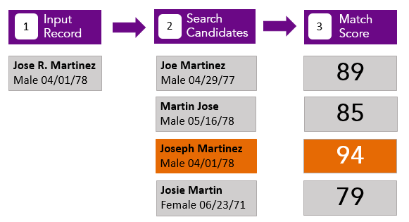
Matching Process Example
Notes:
Let’s look at an example of a record going through the matching process.
click
1. Staff Jose R. Martinez is submitted to the system.
2. The matching engine develops a candidate record index containing all the records that the matching engine thinks might match the input record. The matching engine logic takes into account spelling errors, nicknames, etc.
3. Then the matching engine compares the submission or input record, to each record in the Staff ID system and assigns a match score for each comparison.
Here you can see the match score results when comparing the submission or input record to the Staff ID system.
The match score is used to determine whether or not the input record is a match, a near match or no match to any of the Staff ID records. When making this decision the matching engine takes into account the thresholds that have been configured.
In this example, we can see that Jose R. Martinez and Joseph Martinez share a partial match on the first name, matching last name, and matching gender and birthdate. He therefore received the matching score of 94. This record is considered a match.

Slide 23
Session Agenda
Staff ID Overview
ID Assignment Process
Near Match Resolution
Troubleshooting Validation Issues
System Tools
Support and Resources
01
02
03
04
05
06
Notes:
Next up – the ID assignment process

Slide 24
02
ID Assignment Process
Notes:
Now we will go through the ID assignment process and view the application screens for each step in the process.

Slide 25
ID Assignment Process Green Light Path: Topics
File Format specifications
Review of the steps of the ID assignment process
Retrieving Batch Information
Notes:
In this section, we will cover:
File Format specifications
Review the steps of the ID assignment process
Retrieving Batch Information

Slide 26


Batch File Format
Detailed information is available in Batch File Layout v3.0.
Notes:
The Detailed file format information is available in Batch File Layout v3.0.

Slide 27
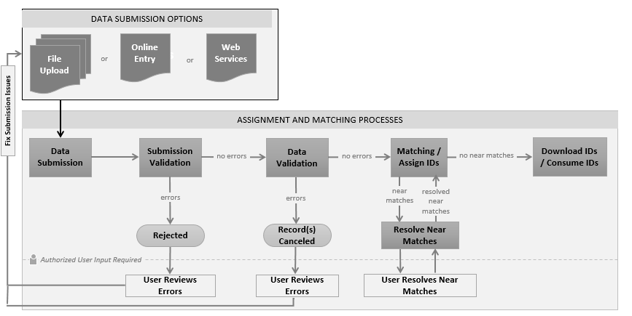
ID Assignment Process
Notes:
Let’s take a look at the File Validation process.

Slide 28
File Validation
System performs a review of the format and layout for the submitted batch file.
The submitted batch file is compared to the Staff Batch File v3 required format.
The results of the validation are either File Upload Failure or File Upload Success.
Files that fail file validation are rejected by the system and will need to be resubmitted by the user after the errors have been corrected.
Notes:
During file validation:
System performs a review of the format and layout for the submitted batch file.
The submitted batch file is compared to the Staff Batch File required format.
The results of the validation are either File Upload Failure or File Upload Success.
Files that fail file validation are rejected by the system and will need to be resubmitted by the user after the errors have been corrected.

Slide 29
File Validation
Filenames can contain upper/lower case alphanumeric characters, periods, underscores or hyphens.
No spaces or special characters.
File names do not have to be unique, although for administrative purposes a time stamp would be beneficial.
Notes:
During file validation the system checks the file name properties:
Filenames can contain upper/lower case alphanumeric characters, periods, underscores or hyphens.
No spaces or special characters.
File names do not have to be unique, although for administrative purposes a time stamp would be beneficial.

Slide 30
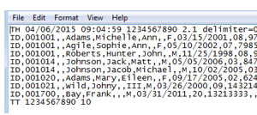
File Validation: Basic Format
Header Record: TH
Detail Record: ID
Trailer Record: TT
  **no empty spaces or data after last trailer column**
Notes:
A header record and trailer record are required.
The header record is the first line of data in the file and the trailer record is the last.
In addition, the header record is identified with a TH and the Trailer Record starts with TT.
Next Lets look at the information that can be in a detail record

Slide 31
Field Names
Current District Code (R)
Current School Code (R)
Resident District Code (Non-R)
Last Name (R)
First Name (R)
Middle Name
Name Suffix
Gender (R)
Date of Birth (R)
Classification Level (R)
Local Staff ID (R)
Social Security Number
Race
State ID
Current School Year (R)
Location (R)
File Format v3: Field Names
(R) = Required Field
Notes:
This is a partial list of the fields in the detail record.
Please reference the file format document provided by LDE for a complete list of fields and the required format.

Slide 32
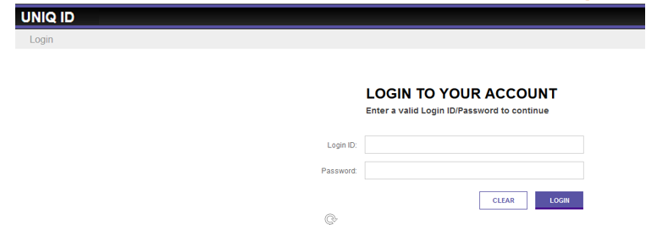
Access the Application
Enter the URL, supply login ID and password.
Do not request that browser save your login information.
Notes:
To access Louisiana Secure ID, Enter the URL and Supply your login ID and password
The application does not save login information for security reasons.
However, the browser may ask you if you want the login information saved.
Do NOT saved your password in your browser.

Slide 33

Staff ID Home Page: Locate Drop Down Menu
Use the menu icon to locate the drop down menu.
Notes:
Now lets go through the ID assignment process within the application.
The first step is to locate the drop down menu on the home page.

Slide 34
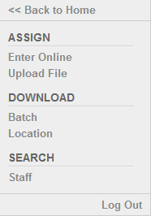
Upload Batch File: Upload
Select Upload File from the menu.
Notes:
Select Upload File from the menu.

Slide 35
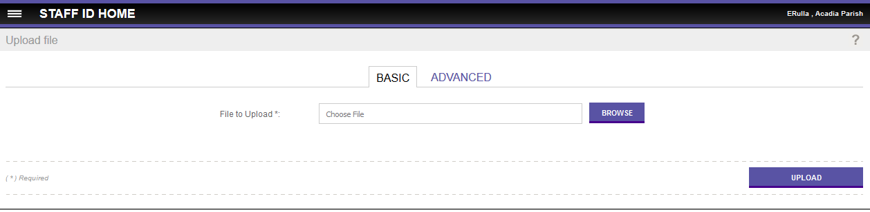
Basic and Advanced Upload
Two types of batch uploads: Basic and Advanced.
The default upload type is Basic.
Notes:
There are two types of batch uploads: Basic and Advanced
LDE default upload type is Basic
Users are recommended to only use Basic for now.
To use advanced upload you need to know more information about file format.
There is nothing preventing you from using advanced upload but unless you are very familiar with the file format you are likely to have trouble using advanced upload

Slide 36
Upload A File
Use Browse button to navigate to the desired file to be uploaded and click Upload.
Basic Upload requires a header and trailer record in the uploaded file.
Notes:
Use browse button to navigate to the desired file to be uploaded
Click Upload
Basic Upload requires a header and trailer record in the uploaded file

Slide 37
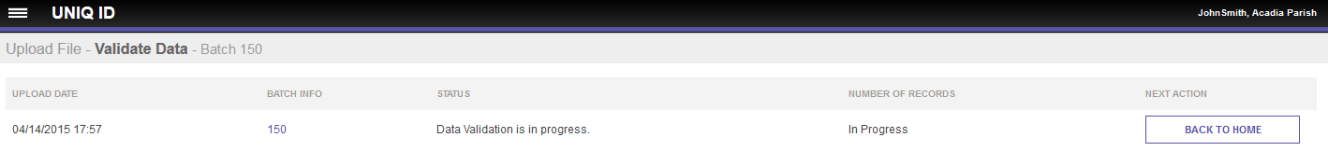
Data Validation
Batch passed file validation and has been assigned an individual Batch ID.
The data validation step will be set to automatically proceed if the file passed file validation.
The status indicates that data validation is in progress.
Notes:
The file has passed file validation and has automatically proceeded to data validation.
The status indicates that data validation is in progress.
The Staff ID screens do not refresh automatically, so returning to the home page will update the status.
Note that the Batch has been assigned an individual Batch ID.

Slide 38
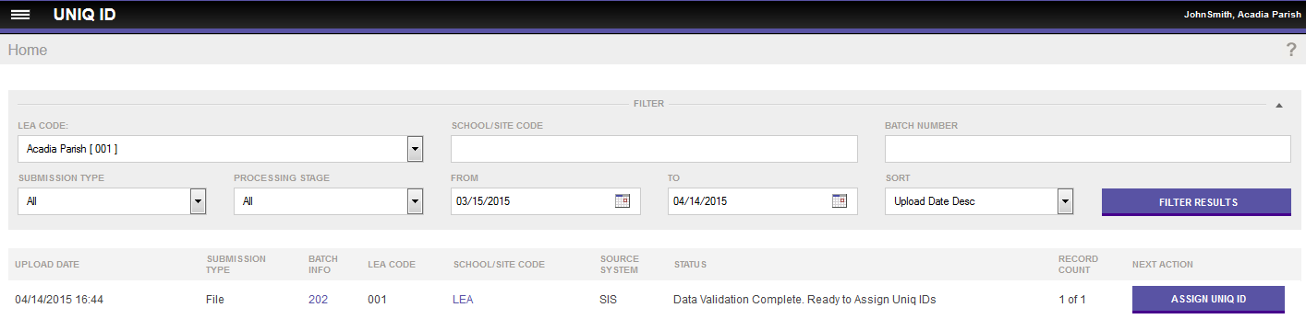
Access Batch Information
Access detailed batch information by drilling into the batch number in the batch info column on any screen.
Notes:
Batch information can be accessed at anytime from any screen with the batch info column.
Access detailed batch information by drilling into the batch number in the batch info column

Slide 39
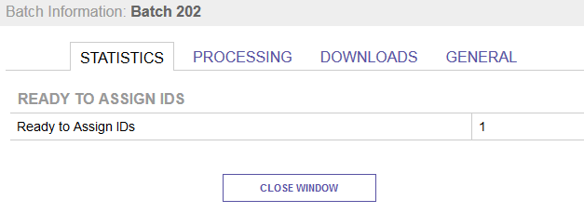
Batch Information:
Provides additional information about the Batch:
  Batch Statistics
  Processing Info
  Download Info
  General Info
Notes:
The Batch Info provides additional information about the Batch such as:
Batch Statistics
Processing Info
Download Info
General Info

Slide 40
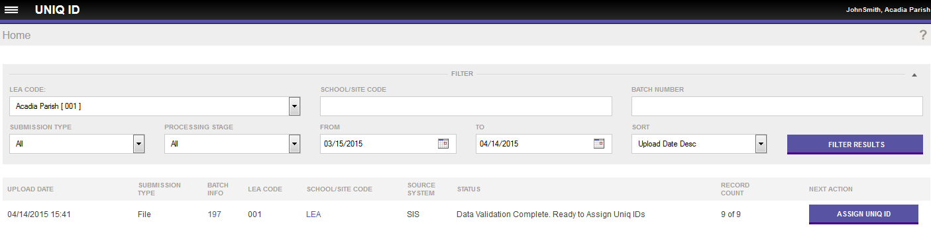
Assign Staff ID
The status indicates that data validation is complete.
The next action is Assign IDs.
Notes:
Click on the Assign Id button to submit the batch to the matching engine for processing and ID assignments

Slide 41

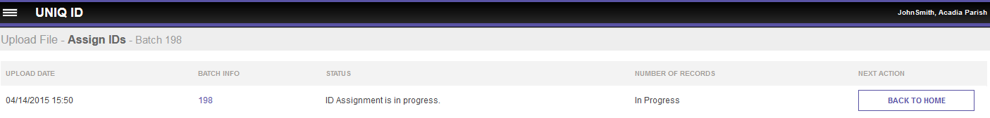
ID Assignment in Progress
System indicates that ID Assignment is in progress.
Notes:
The System indicates that the ID Assignment is in progress.
To refresh the screen click on the back to home button

Slide 42
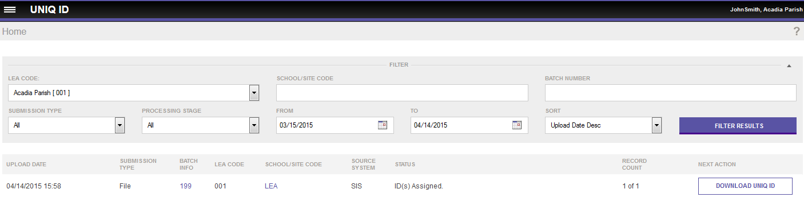
Download Staff ID
The status is ID(s) Assigned, which means the process is complete.
The next action is Download Staff ID.
Notes:
The status is ID(s) Assigned, which means the process is complete.
The next action is to Download the Staff IDs.

Slide 43
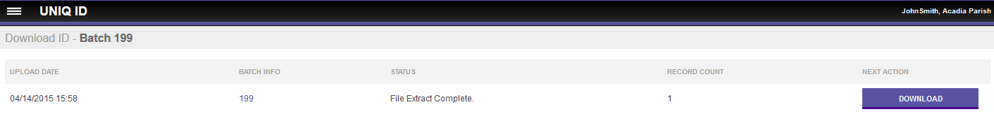
Download File
Records can be extracted from this batch using the download button.
Notes:
User can extract records from this batch with the download button

Slide 44
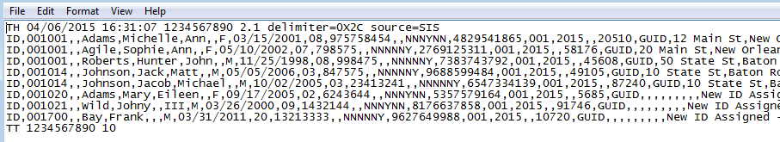
Download Staff ID: New ID Assigned
Note that you can see the newly assigned 10 digit ID for each record
and the Status is “New ID Assigned”.
This file can be used to update staff record information in the local source system.
Notes:
This is an example of the extracted record
Note that you can see the newly assigned ID—it is a 10 digit ID
If the submission file is from an authoritative source then this file can be used to update staff record information in the local source system
Also note that the download file contains that message that a new id was assigned.
This concludes the ID assignment process

Slide 45
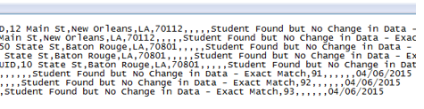
Download Staff ID: Match Found
The output file contains each of the submitted IDs with a status and the Staff ID.
In this example, the Status indicates that these records returned as
Staff Found but no Change in Data – Exact Match.
Notes:
Here is a different example of an output file when each staff member that was submitted already has a State ID.
The output file contains each of the submitted IDs with a status and the Staff ID.
In this case, the Status indicates that these records returned as Staff Found but no Change in Data – Exact Match.

Slide 46
LEA Downloading and Retrieving IDs
Download by Batch
From the menu, select Download, then Batch
Records retrieved by Download by Batch will return all of the Staff records with IDs that were assigned in a given batch.
Download by Location
From the menu, select Download, then Location
Records can be downloaded by location/agency for currently enrolled Staff members.
Notes:
LEAs can download and retrieve IDs by batch and/or location:
Download by Batch
From the menu, select Download, then Batch
IDs downloaded by batch will return all of the IDs that were assigned in a given batch
Only IDs contained in the given batch number will be downloaded, regardless of location.
Download by Location
From the menu, select Download, then Location
IDs can be downloaded by location/agency for current staff
All IDs for the given location will be downloaded, regardless of batch number.

Slide 47
Poll #1
Show Poll in Webinar
Notes:
Let’s take a look at a poll in the webinar. Just click on the best answer on your screen.

Slide 48
Poll #1
Which of the following outcomes of assigning Staff IDs requires human intervention to resolve?
        Answer:
                Match
                Near Match
                No Match
                All of the above
Notes:
Which of the following outcomes of assigning Staff IDs requires human intervention to resolve?
Answer: Near Match

Slide 49
Poll #2
Show Poll in Webinar
Notes:
Poll #2-select the best answer

Slide 50
Poll #2
Users can download the assigned Staff IDs by which of the following:
        Answer:
                Online Entry
                Data Validation
                Batch and Location
                All of the above
Notes:
Users can download the assigned Staff IDs by which of the following:
Answer: Batch and Location

Slide 51
Session Agenda
Staff ID Overview
ID Assignment Process
Near Match Resolution
Troubleshooting Validation Issues
System Tools
Support and Resources
01
02
03
04
05
06
Notes:
Now let’s look at the near match resolution process

Slide 52
03
Near Match Resolution
Notes:
The matching process and Near Match Resolutions

Slide 53
Matching Process & Near Match Resolution
The Matching Process
Near Match Rules
Resolving Near Matches
Notes:
We have navigated through the Staff ID process with no errors.
Next we will review the matching process in depth.
Then we will look at how near matches are resolved through the application.

Slide 54
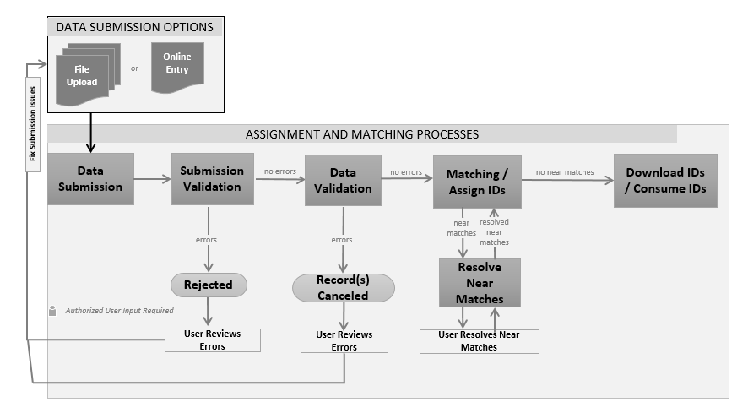
ID Assignment Process
Notes:
We’ve already reviewed a brief overview of the matching process.
In this next section we will be discussing in more detail the process which the matching engine goes through when a submission record is received by the system.
This is where most of the work being done by the application occurs.

Slide 55
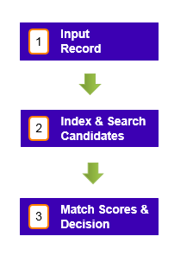
Overview of Matching Process
MATCH PROCESS
Proven workflow and matching algorithms.
Notes:
During the matching process:
Input Records are submitted to the system.
Matching engine develops an index of records.
Matching engine compares input records to the Staff ID records and provides a match score and match decision.

Slide 56
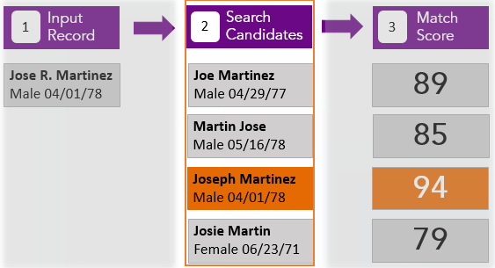
During the matching process the system:
System searches the Staff ID system.
Generates search candidates based upon combinations of the name.
Notes:
During the matching process the system searches the Staff ID system for possible candidates that match the input record.

Slide 57
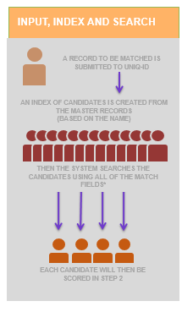
MATCHING ENGINE
Last Name: High Weight, Required
First Name: High Weight, Required
Middle Name: High Weight
Birth Date: Medium Weight, Required
Gender: Low Weight, Required
Notes:
The Matching Engine uses the last name, first name, birth date and, gender for matching. The middle name will be used if provided. The system then searches the data in the Staff ID Index using the matching fields.

Slide 58
Matching Engine Exceptions:
EXAMPLES OF EXCEPTIONS
Errors in spelling: Tomas instead of Thomas
Nicknames: Bill or William
Mixed usage: John Thomas or Thomas John
Multi-part names: Anderson-Lott or Lott
Uncommon Names: Leniency on misspellings
Punctuation: Removes punctuation
Matching engine employs over 300 different algorithms to match names.
Notes:
The matching engine accounts for exceptions such as different spellings, nicknames, hyphenated names, etc.
This is only a partial list of the exceptions.
The Matching engine employs 300 different algorithms to catch different variations.

Slide 59
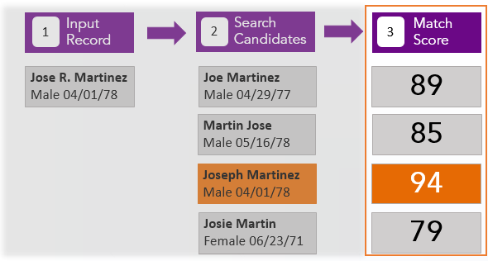
Match Scores and Match Decisions:
Based upon the search results, the system generates a Match Score.
Notes:
Based upon the search results, the system generates a Match Score for each record. In this example, we can see that Joseph Martinez is the closest match to the input record and is given a match score of 94.

Slide 60
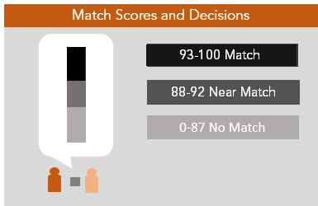
Match Score Thresholds
Match decision determined by comparing the match score to the thresholds.
Notes:
After the match score is generated the system makes a match decision.
The Match decision is determined by the match score and by comparing the match score to system thresholds.
The Louisiana thresholds are 93 and above is a match, 88-92 is a near match and zero to 87 is a no match.
Thresholds can be configured by the system administrator.
Louisiana’s match thresholds are the same as those shown on the screen.

Slide 61
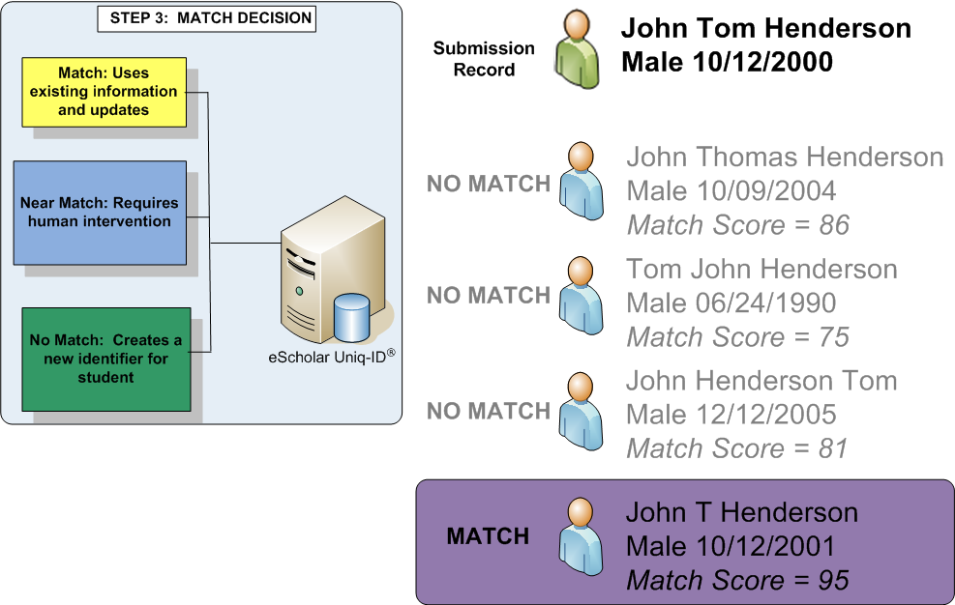
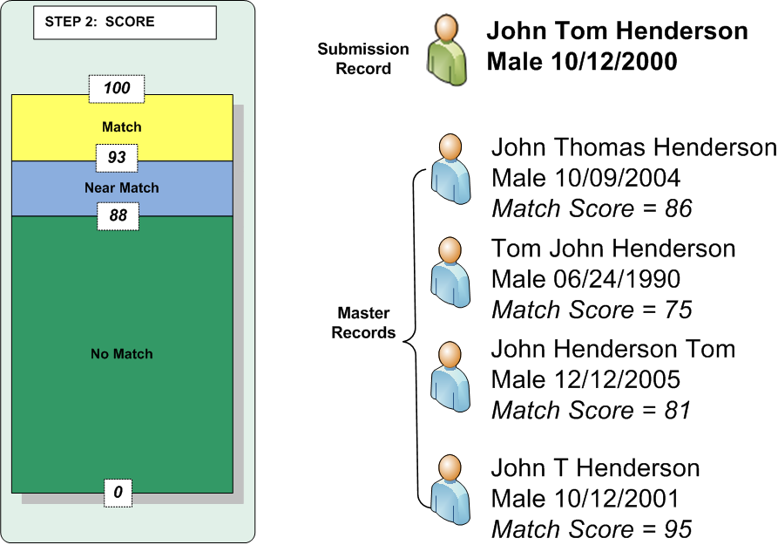
No Match
Input Record:
Jose Martinez
Male 10/12/2001
No Match
Master Record:
Christopher M. Swanson
Male 10/12/2001
Match Score = 65
No Match
If the system finds no matching Staff it will assign a new Staff ID to the submission record.
These records do not need to be reviewed.
Notes:
If the system finds no matching Staff it will assign a new Staff ID to the submission record.
These records do not need to be reviewed.

Slide 62
Match
Input Record:
Jose Martinez
Male 10/12/2001
Master Record:
Jose Martinez
Male 10/23/2001
Match Score = 96
If the system finds a Match it assigns the ID of the matching Staff to the input record.
If demographics are different between the input record and the master record, and the input record comes from an authoritative source, the input record updates the master record.
Previous Master record gets moved to the ID history.
Notes:
If the system finds a Match it assigns the ID of the matching Staff to the input record.
If demographics are different between the input record and the master record, and the input record comes from an authoritative source, the input record updates the master record.
Previous Master record gets moved to the ID history.

Slide 63
Near Match
Input Record:
Jose Tommy Martinez
Male 10/12/2000
Near Match
Master Record:
Joe Thomas Martinez
Male 10/12/2004
Match Score = 91
Near Match
The Staff ID system can not determine whether or not these Staff members are the same person. Near matches require human intervention to resolve.
Notes:
In this example names are close but not exact.
The Birthdates are close.
The Match score flags this as a near match.
Since the Staff ID system can not determine whether or not these Staff members are the same person, human intervention will be required to resolve this match decision.

Slide 64
Multiple Matches
John T Henderson
Male 10/21/2000
Match Score = 96
John Thomas Henderson
Male 10/12/2001
Match Score = 94
If two or more potential matches are found above the matching threshold, the system forces a near match.
Notes:
Multiple Matches
If two or more potential matches are found above the matching threshold, the system forces a near match. The near match will require human intervention to resolve.

Slide 65
Twins Rule
District: 001
Local ID: ABCDEF
John Thomas Henderson
Male 10/12/2000
District 001
Local ID: UVWXYZ
Match Score = 94
If the submission record is a match to a master record, and the district is the same, but the local ID is different, then the system forces a near match.
Notes:
If the submission record is a match to a master record, and the district is the same, but the local ID is different, the system will force a near match.

Slide 66
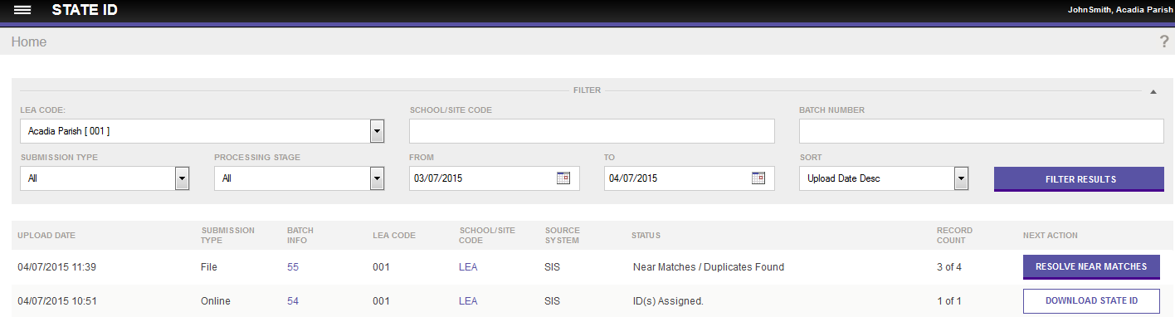
Resolve Near Matches
The Status of Batch 55 indicates there are Near Matches/Duplicates Found.
The Next Action is Resolve Near Matches.
Human intervention required for near match resolution.
Notes:
Now let’s look at what resolving near matches looks like in the application.
Here is an example:
The Status of Batch 55 indicates there are Near Matches/Duplicates Found.
The Next Action is Resolve Near Matches.
Human intervention required to determine whether the submission record matches the master record
The submission record is viewed side by side with master record in the application to determine the differences

Slide 67
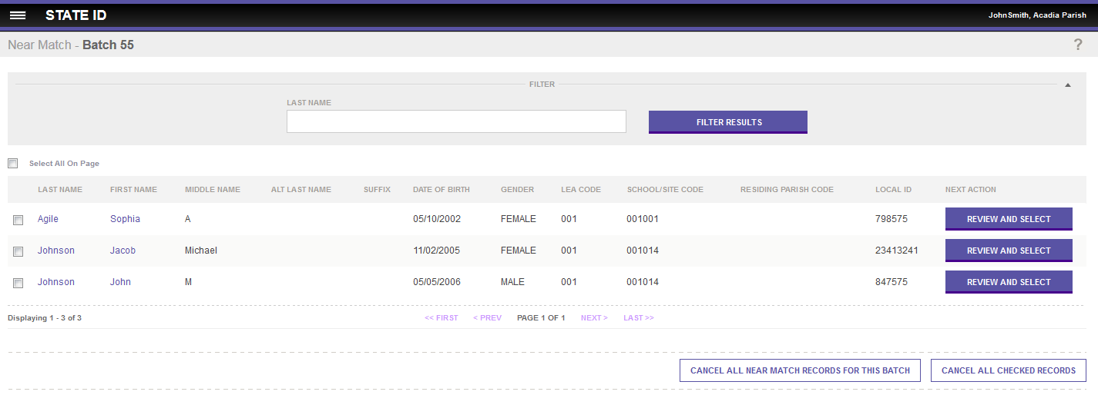
List of Near Matches
There are three instances of a near match from this batch.
Review and Select allows users to drill down into the comparison details for each near match.
Notes:
In this view, there are three instances of a Near Match from this batch.
Review and Select allows users to drill down into the comparison details for each near match.

Slide 68
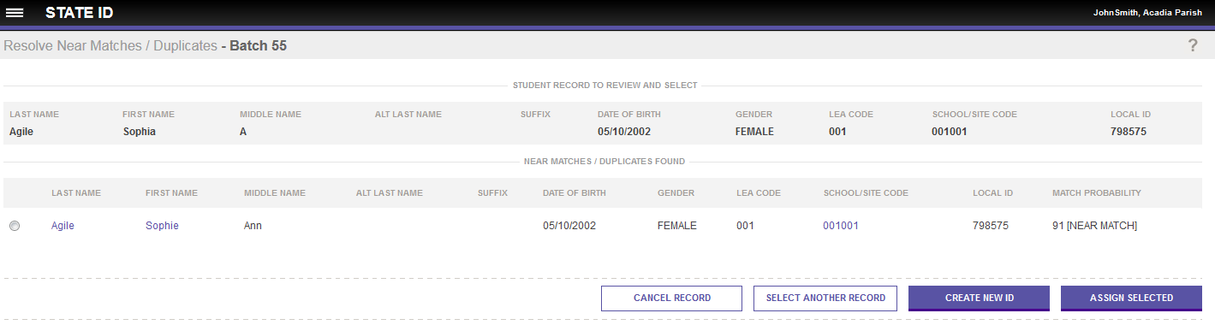
Initial Near Match Comparison
Resolve Near Matches: The Staff record to review and the near match record are displayed.
Actions are Assign Selected, Create New ID, Cancel Record or Select Another Record.
The Staff record name is a drill down to the detailed comparison screen.
Notes:
This screen displays the Staff Record to Review and the Near Match Found.
You may be able to tell from this information whether or not these two records match in which case you can perform one of the actions
The actions are
Assign Selected
Create New ID
Cancel Record
or Select Another Record.
You may need to drill down to compare the full records side by side to determine if the records are the same.
The staff member record name is a drill down to the detailed comparison screen.

Slide 69
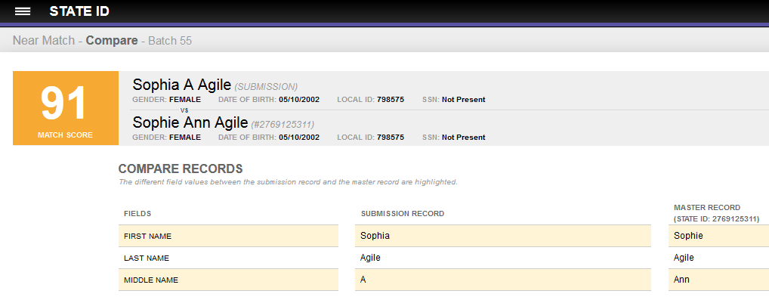
Compare Staff Information
The match score and the primary staff information from both the master record and the submission record are displayed.
Notes:
When the user drills down on the staff name, the match score and the primary staff information from both the master record and the submission record are displayed.

Slide 70
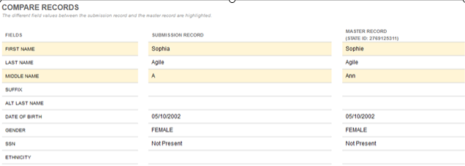
Compare Staff Information
Fields that are different between submission record and master record are highlighted in yellow.
Notes:
This is only a partial screenshot – all fields in the submission record are displayed for comparison purposes
Fields that are different between the submission record and the master record are highlighted in yellow.

Slide 71
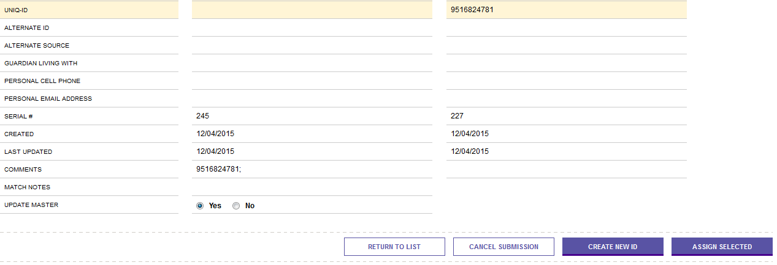
Make a Match Decision
User decides whether or not these two records are a match:
  If no match, then Create New ID.
  If match, then Assign Selected.
The user can also cancel the submission or return to list of near matches.
Notes:
Now, I’ve scrolled down to the bottom of the compare records screen.
The User decides whether or not these two records are a match
If there is no match, then the user selects Create New ID
If there is a match, then the user selects Assign Selected
The user can also cancel the submission or return to the list of near matches
In this case, I’ve investigated the differences and I’m going to say that these two records are a match.

Slide 72
Updating the Master Record
If you choose “Assign Selected” then you have a choice whether to update master record.
Notes:
If you choose “Assign Selected” then you have a choice whether to update master record.

Slide 73
Updating the Master Record
Q:
What happens when I select “Yes” for the “Update Master” radio button?
A:
The information contained in the submitted record becomes the record’s current information or Master Record.
  The information of the master record becomes part of that record’s history.
  The default is to update master.
Notes:
Q:
What happens when I select “Yes” for the “Update Master” radio button?
Click to See the Answer (Pause)
A:
The information contained in the submitted record becomes the record’s current information or Master Record.
The information of the master record becomes part of that record’s history.
The default is to update master.

Slide 74
Updating the Master Record
Q:
What happens when I select “No” for the “Update Master” radio button?
A:
The submission record will be assigned the matching record’s Staff ID, but the master record will not be updated with the submission record’s information.
Notes:
Q:
What happens when I select “No” for the “Update Master” radio button?
Click to See the Answer (Pause)
A:
The submission record will be assigned the matching record’s Secure ID, but the master record will not be updated with the submission record’s information.

Slide 75
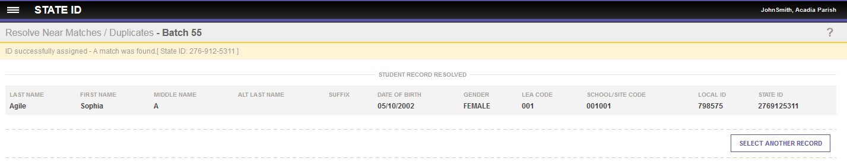
Match Decision: Assign Selected
Staff ID from the master record has been assigned to the submission record.
Select another record to continue resolving near matches.
Notes:
I have decided that the input record matched the master record so the Staff Id from the master record has been assigned to the submission record.
Now I can go on to resolve another near match.

Slide 76
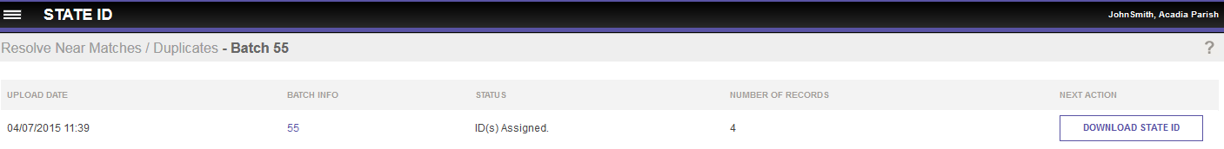
ID Successfully Assigned
The status indicates that all IDs have been assigned and are ready to be downloaded.
All the near matches in a batch must be resolved or canceled before the batch moves automatically to assign Staff IDs.
Notes:
Now the status indicates that all IDs have been assigned and are ready to be downloaded.
All the Near Matches must be resolved or canceled before the batch moves automatically to Assign State IDs.

Slide 77
Consequences of Erroneous Match Decisions
Duplicate IDs
  Sometimes created by selecting ‘Create New ID’ when the user should have selected ‘Assign Selected’.
Shared IDs
  Sometimes created by selecting ‘Assign Selected’ when the user should have selected ‘Create New ID’.
Notes:
What happens if a user mistakenly makes a poor match decision? The result will be Duplicate IDs or Shared IDs.
1. Duplicate IDs -
These are sometimes created by the user selecting ‘Create New ID’ when the user should have selected ‘Assign Selected’. Now a single Staff member will have two Staff IDs.
2. Shared IDs -
These are sometimes created by the user selecting ‘Assign Selected’ when the user should have selected ‘Create New ID’. Now two different Staff members share a Staff ID.
Duplicate IDs and Shared IDs Must be fixed by an administrator.

Slide 78
Duplicate IDs
Duplicate IDs are created when a Staff is mistakenly assigned two or more Staff IDs.
Resolution: Retire ID and move data to history.
This will require you to contact support for assistance.
Staff ID: 1234
1234
1111
2222
3333
4444
5555
Notes:
Duplicate IDs are created when a single Staff is mistakenly assigned two or more Staff IDs.
The Resolution will require the state to Retire an ID and move the data to history.
The district will need to use the Retire ID Request Form and provide information about the Staff in order to resolve the duplicate ID.

Slide 79
Shared IDs
A Shared ID occurs when two separate Staff members are both using the same Staff ID.
Resolution: Separate IDs
This will require you to contact support for assistance.
Jon Thomas Henderson
JT Henderson
Staff ID: 12345
Notes:
A Shared ID occurs when two separate Staff members are both using the same Staff ID.
The Resolution is to Split IDs.
During a near match resolution, the user assigned an already assigned ID to a newly submitted record.
So “Assign selected” was chosen when two records in a near match state are actually 2 different Staff members.
The district will need to use the Split IDs Request Form and provide information about the Staff members in order to resolve the Shared ID.

Slide 80
Duplicate ID and Shared ID Resolutions
To fix a duplicate or shared ID contact EdLink360@la.gov
Request the appropriate form listed below:
  ID Retirement request form (for Duplicate IDs)
  Split ID request form (for Shared IDs)
Notes:
To fix a duplicate or shared ID contact EdLink360@la.gov
Request the appropriate form listed below:
ID Retirement request form (for Duplicate IDs)
Split ID request form (for Shared IDs)

Slide 81
Exact Match
A Staff with a Staff ID may be submitted to the system during a batch upload.
The system is set to check for an exact match of the Staff ID, Last Name, and First Name.
If the data matches exactly, the Staff will skip the matching engine entirely and be returned in the results with the existing Staff ID.
The Staff ID can then be downloaded in the Batch Download.
Notes:
An Exact Match is also possible.
A Staff with a Staff ID may be submitted to the system during a batch upload.
The system is set to check for an exact match of the Staff ID, Last Name, First Name and Birth Date.
If the data matches exactly, the Staff will skip the matching engine entirely and be returned in the results with the existing Staff ID.
The Staff ID can then be downloaded in the Batch Download.

Slide 82
Near Match Decision Best Practices
Compare all the data provided in the side by side comparison, not just the required fields.
Speak with the staff member involved in the near match.
Notes:
Compare all the data provided in the side by side comparison, not just the required fields.
Speak with the staff member involved in the near match.

Slide 83
Poll #3
Show Poll in Webinar
Notes:
Time for another poll question.
Once again, select the best answer.
Here we go…

Slide 84
Poll #3
What is it called when a Staff is mistakenly assigned two or more Staff IDs?
        Answer:
                Duplicate IDs
                Shared IDs
                Cancelled IDs
                All of the above
Notes:
When a Staff is mistakenly assigned two or more Staff IDs it is called?
Answer: Duplicate IDs

Slide 85
Poll #4
Show Poll in Webinar
Notes:
Poll #4-select the best answer on your screen.

Slide 86
Poll #4
What is it called when two staff members share the same Staff ID?
Answer:
                Validated IDs
                Duplicate IDs
                Shared IDs
                All of the above
Notes:
What is it called when two staff members share the same Staff ID?
Answer: Shared IDs

Slide 87
Session Agenda
Staff ID Overview
ID Assignment Process
Near Match Resolution
Troubleshooting Validation Issues
System Tools
Support and Resources
01
02
03
04
05
06

Slide 88
04
Troubleshooting Validation Issues
Notes:
Troubleshooting Validation Issues

Slide 89
Troubleshooting Validation Issues: Topics
File Validation Issues
Locating Rejected Files
Data Validation Errors
Notes:
In this section, we will discuss File Validation Issues, Rejected Files and Data Validation Errors.

Slide 90
File Validation
Notes:
First lets look at File validation issues
Here are some of the most common reasons for file validation failing

Slide 91
File Validation Issues
Rejection of a Staff Batch File will occur if:
  1+ record types are missing.
  1+ fields have been omitted from a record.
  The “Number of Records” field in the trailer record is incorrect.
  Transmission ID in header and trailer records don’t match.
  Maximum # of allowable detail record errors has been exceeded.
Notes:
A Staff Batch File will be rejected if:
1+ record types are missing.
1+ fields have been omitted from a record.
The “Number of Records” field in the trailer record is incorrect.
Transmission ID in header and trailer records don’t match.
Or the maximum # of allowable detail record errors as defined by state has been exceeded.

Slide 92


1+ Record Types are Missing
Either the Header, Detail or Trailer Record is missing.
Notes:
Either the Header, Detail or Trailer Record is missing.
In this example we see that the Trailer record, designation with ‘TT’, is missing. This file will be rejected because it is not complete.

Slide 93
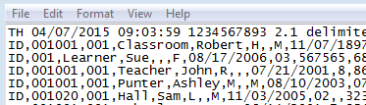
One or More Field Types are Missing
If the entire field is missing in one or more rows the file will be rejected.
Notes:
In this example, the entire field is missing in one or more rows and the file will be rejected.
The school number field is missing from the record of Sue Learner.

Slide 94

Number of Records is Incorrect
The “Number of Records” field in the Trailer Record is incorrect.
  This number should be the sum of all the records in the file, including the Header and Trailer Records.
Notes:
In this example, the “Number of Records” field in the Trailer Record is incorrect.
This number should be the sum of all the records in the file, including the Header and Trailer Records.
In the example, the count is off by one.

Slide 95

Transmission ID Doesn’t Match
The Transmission ID in the Header and Trailer Records does not match.
Notes:
The Transmission ID in the Header and Trailer Records needs to match.
In the file shown, the ID is 1234 in the Header and 88888 in the Trailer.

Slide 96
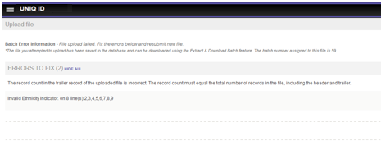
File Failed Upload Message
The status indicates the file failed upload because the record count in the uploaded file is incorrect.
The rejected file can be downloaded under the Extract & Download Batch feature.
Notes:
The status indicates the file failed upload because the record count in the uploaded file is incorrect.
The status also indicates that the rejected file can be downloaded under the Extract & Download Batch feature

Slide 97
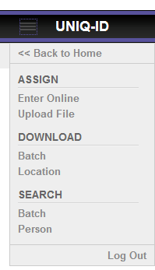
Download Batch
Select the Batch link under the menu.
Download batch is used to retrieve all Staff IDs for the batch.
Notes:
To download a batch, select the Batch link under the menu. Download batch is used to retrieve all Staff IDs for the batch.

Slide 98
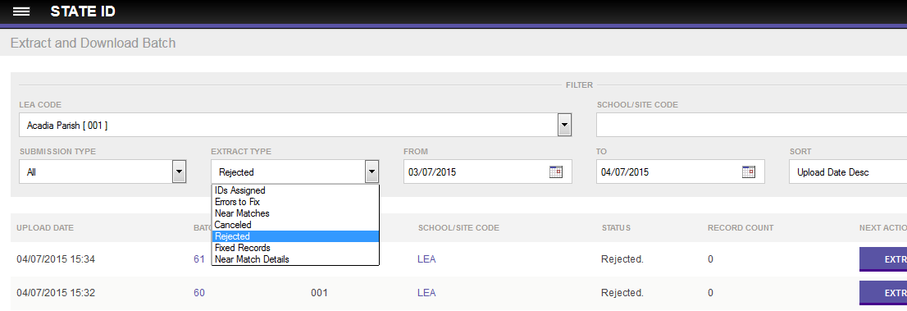
Extract and Download Batch
Rejected - Files rejected by the system due to file validation errors.
Canceled - Records auto canceled by the system due to data validations errors.
Notes:
All Batch Files, even those rejected by the system, can be located using the Extract and Download Batch function

Slide 99
Data Validation
Notes:
We just reviewed some of the common errors that you might receive during the file validation process.
Now lets explore some of the errors that you might receive during the data validation process

Slide 100
Data Validation: Examples
Data Validation process checks to ensure:
  Dates are correct
  Codes are valid
  Data is in the expected format
Notes:
The Data Validation process checks to make sure:
Dates are correct
Codes are valid
Data is in the expected format

Slide 101
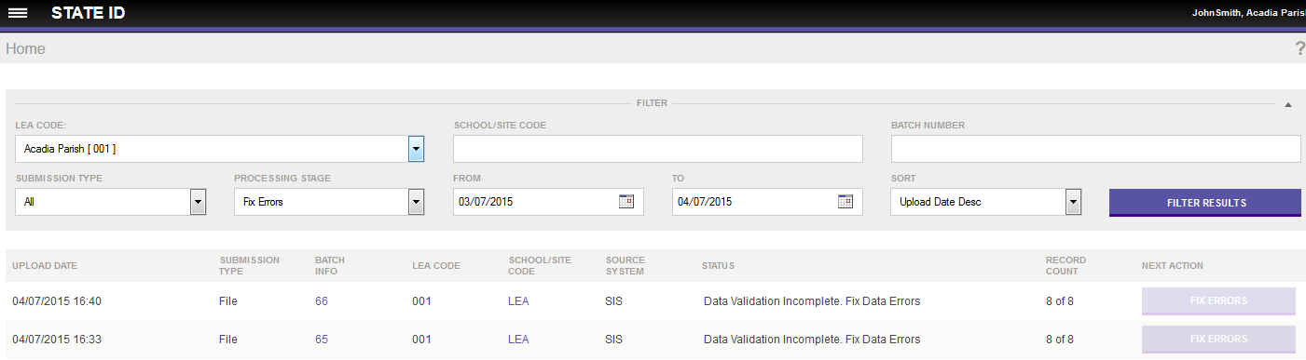
Status: Data Validation Incomplete
The Status indicates that the data validation is incomplete due to data errors.
The Next Action is not highlighted, as Fix Errors is not enabled.
This batch needs to be downloaded from Download Batch.
Notes:
The Status indicates that the data validation is incomplete due to data errors.
The Next Action is not highlighted, as Fix Errors is not enabled.
This batch needs to be downloaded from Download Batch so that we can see the errors and figure out what needs to be fixed.

Slide 102
Download Batch
Select the Batch link under the menu.
Notes:
To access errors from data validation, select the Batch link under the menu.

Slide 103
Downloading Files with Errors
Batches that failed data validation may be download with the error description of:
  Canceled Records
Canceled Records is used when ‘Auto Cancel Records’ is turned on. This property automatically cancels the records that fail data validation so the rest of the batch may continue processing.
Notes:
Batches that failed data validation may be download with the error description in Canceled Records
Canceled Records is used when ‘Auto Cancel Records’ is turned on. This property automatically cancels the records that fail data validation so the rest of the batch may continue processing.

Slide 104
Poll #5
Show Poll in Webinar
Notes:
Lets take a look at Poll #5 – select the best answer

Slide 105
Poll #5
Rejection of a Staff Batch File will occur if:
        Answer:
            1+ record types are missing.
            1+ fields have been omitted from a record.
            The “Number of Records” field in the trailer record is incorrect.
            All of the above
Notes:
Rejection of a Staff Batch File will occur if:
Answer: All of the above

Slide 106
Poll #6
Show Poll in Webinar
Notes:
Poll #6 - select the best answer

Slide 107
Poll #6
Batches that failed data validation may be download with the error description of:
Answer:
                Data Validation
                File Validation
                Canceled Records
                All of the above
Notes:
Batches that failed data validation may be download with the error description of:
Answer: Canceled Records

Slide 108
Session Agenda
Staff ID Overview
ID Assignment Process
Near Match Resolution
Troubleshooting Validation Issues
System Tools
Support and Resources
01
02
03
04
05
06
Notes:
System Tools

Slide 109
05
Staff ID System Tools
Notes:
Staff ID System Tools

Slide 110
Staff ID System Tools: Topics
Staff Search
Download by Location
Notes:
The Staff ID System Tools include Staff Search and Download by Location.

Slide 111
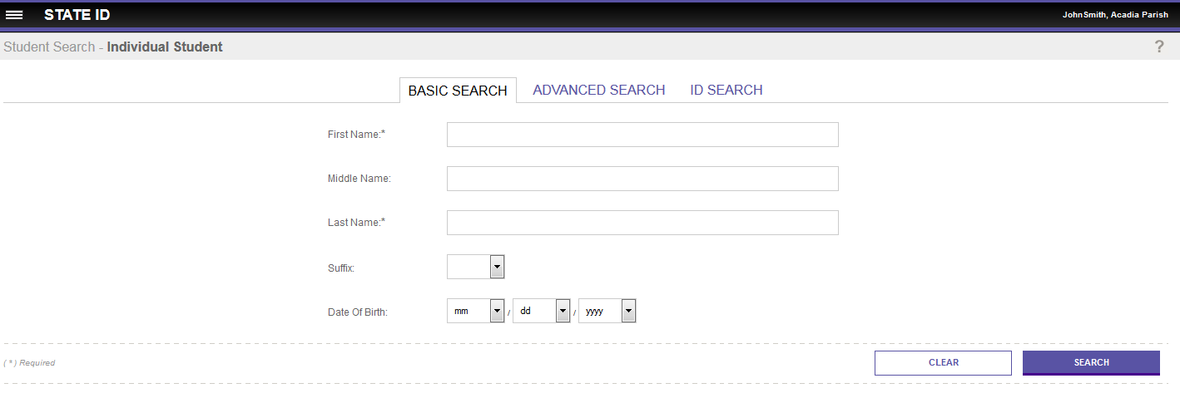
Staff Search Overview
Staff search allows users to search for Staff members using demographic information.
Notes:
Staff search allows users to search for Staff members using demographic information.

Slide 112
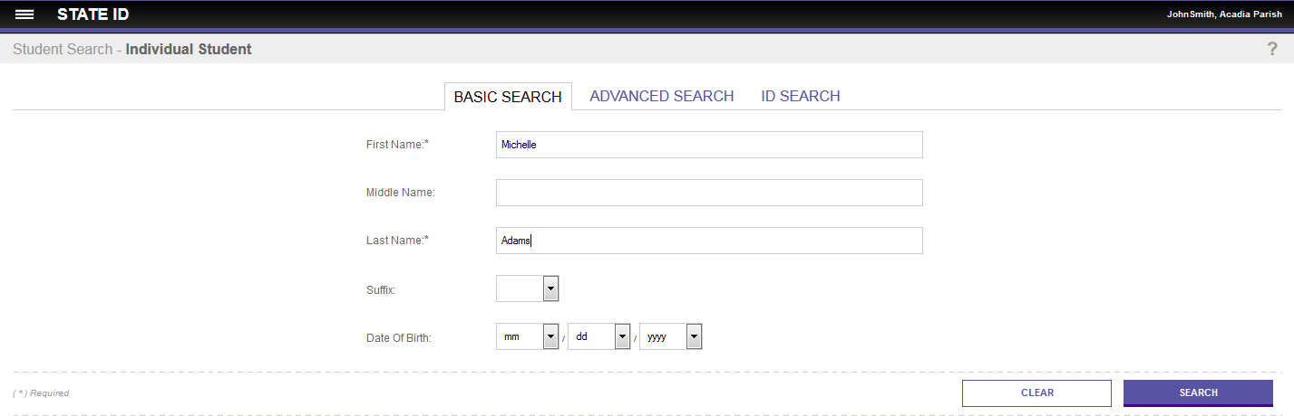
Staff Search Overview
First and last name are required at a minimum.
Adding additional data elements improves the search results.
Notes:
First and last name are required at a minimum.
Adding additional data elements improves the search results.

Slide 113
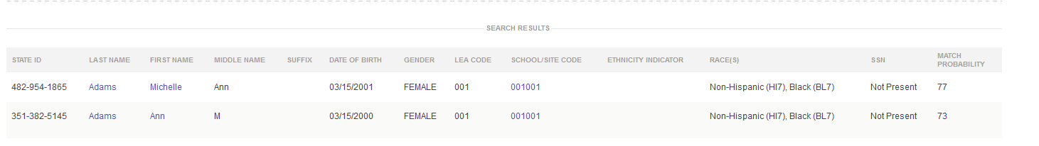
Staff Search Results
The system returns potential matches according to the search parameters.
Each record is returned with a Match Probability score.
The Staff names link to the detailed Staff records.
Notes:
The system returns potential matches according to the search parameters.
Each record is returned with a Match Probability score.
The Staff names link to the detailed Staff records.

Slide 114
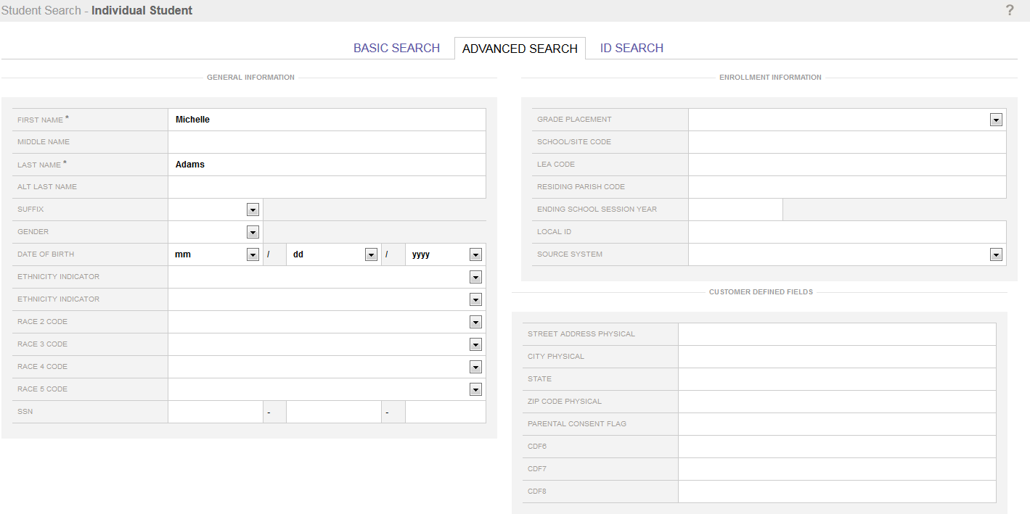
Advanced Staff Search
Advanced search allows a user to enter additional data elements and narrow the results returned.
First and last name are required.
Notes:
Advanced search allows a user to enter additional data elements and narrow the results returned.
First and last name are required.

Slide 115
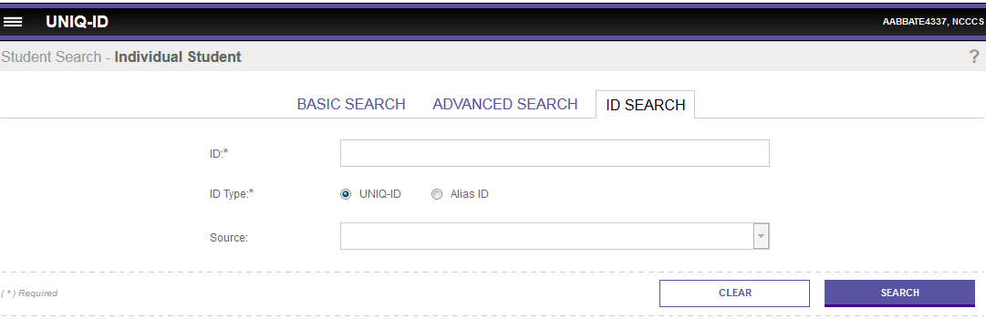
ID Search
The ID Search allows the user to search for a Staff by Staff ID or Alias ID.
The user may also search for a Staff record by any ID associated with the Master Record from a specific source system.
Notes:
The ID Search allows the user to search for a Staff by Staff ID or Alias ID.
The user may also search for a Staff record by any ID associated with the Master Record from a specific source system.

Slide 116
Download by Batch
This will enable download of all IDs that were submitted in the batch.
Notes:
Download by Batch--This will enable download of all IDs that were submitted in the batch.

Slide 117
Download by Location
This will enable download of all IDs for currently enrolled Staff members for a specific location.
Notes:
Download by Location--This will enable download of all IDs for currently enrolled Staff members for a specific location.

Slide 118
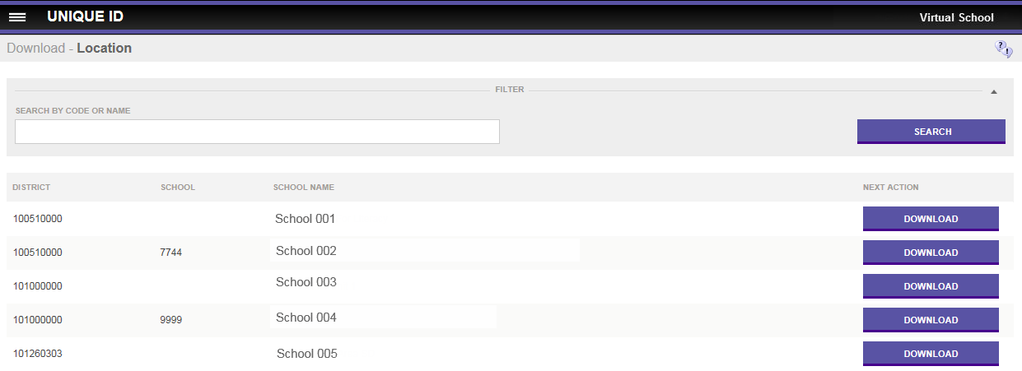
Download by Location
Download by Location allows a user to download Staff IDs for each location the user has the rights to access.
  This will return IDs for current Staff members.
Notes:
Download by Location allows a user to download Secure IDs for each location the user has the rights to access
All the available locations are displayed.
Users can also search by name or location code for a specific location.

Slide 119
Session Agenda
Staff ID Overview
ID Assignment Process
Near Match Resolution
Troubleshooting Validation Issues
System Tools
Support and Resources
01
02
03
04
05
06
Notes:
Support and Resources

Slide 120
06
Support and Resources
Notes:
Support and Resources

Slide 121
LDOE at EdLink360@la.gov
eScholar
Support
Staff ID Pilot Program Support Structure
Notes:
This is the support structure for the pilot program.

Slide 122
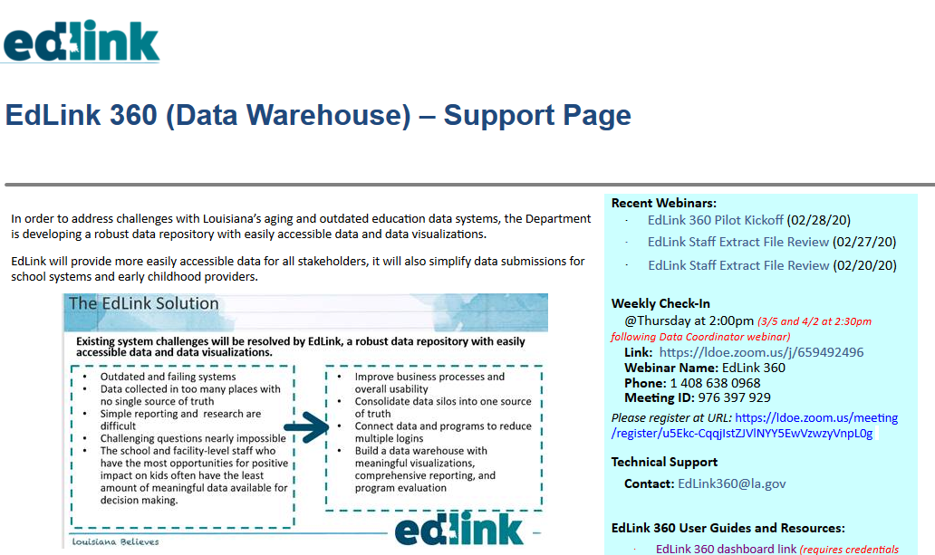
Access the Louisiana EdLink 360 Support website at
https://leads13.doe.louisiana.gov/lug/edLink360/EdLink360.htm
Notes:
The Louisiana EdLink 360 Support website provides a variety of resources to the end user.

Slide 123

The EdLink support page provides the email address for technical assistance.
Notes:
The EdLink support page provides the email address for technical assistance.

Slide 124
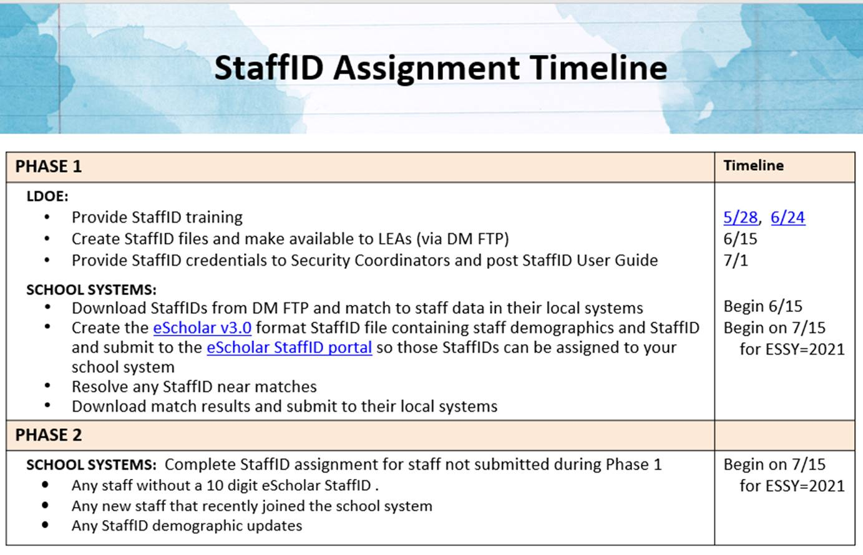
Notes:
The StaffID Assignment Timeline shown was shared on the Louisiana May data coordinator Webinar. Please note the key dates in June and July 2020. I will be providing you with a copy of this slide deck after the webinar.

Slide 125
https://www.surveymonkey.com/r/Staff-ID
The eScholar Training Survey link provided above will be emailed to you in a follow-up webinar email. Please respond to the survey at your earliest convenience.
Notes:
The eScholar Training Survey link provided above will be emailed to you in a follow-up webinar email. Please respond to the survey at your earliest convenience.

Slide 126
Thank You!
Notes:
This concludes our webinar for today. Thank you for your time.

